Slide 1
The Precalculus Center
Building an Inclusive Campus Environment
Steve Benoit Co-director of the Precalculus Center Department of Mathematics

Slide 2
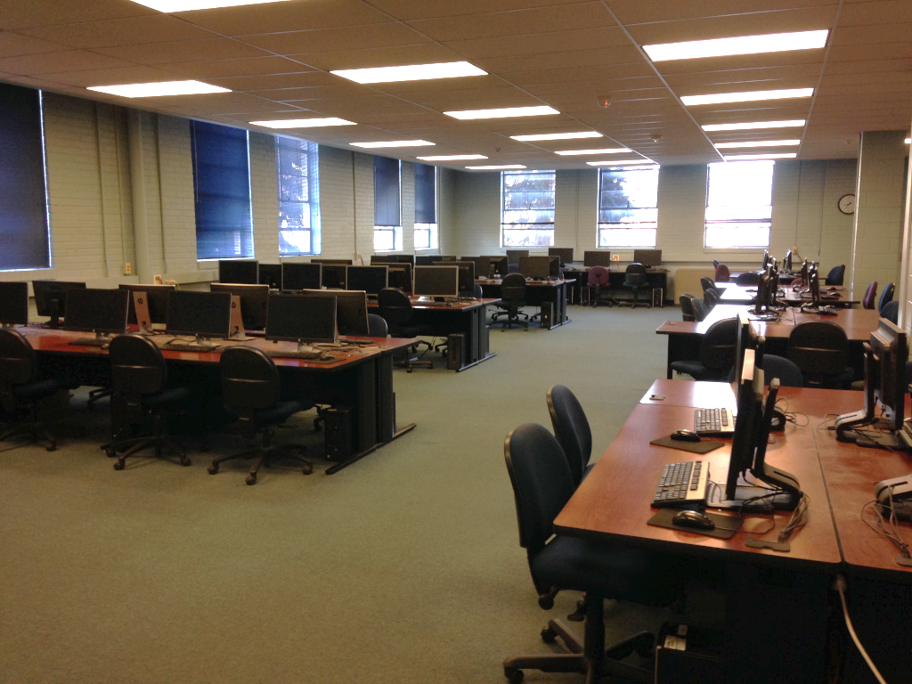
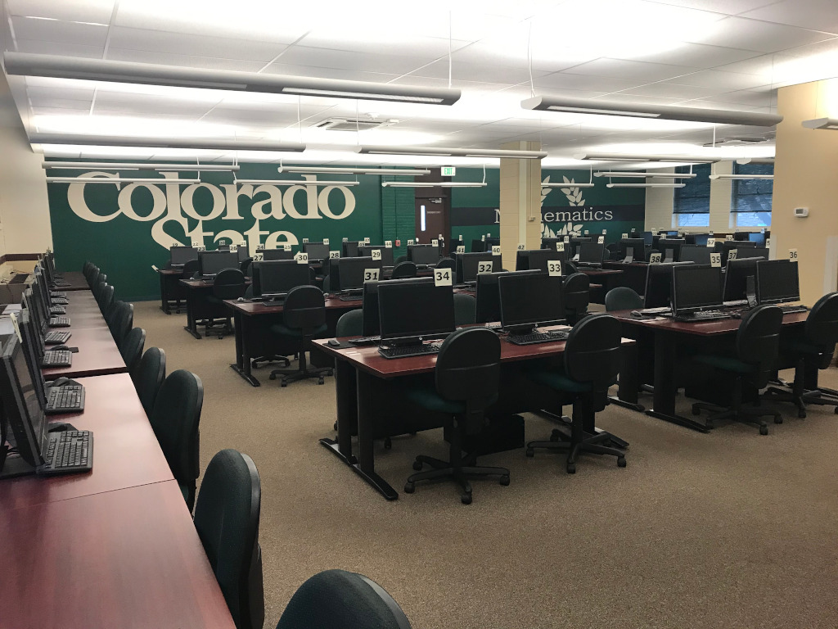
Starting point…
The PACe Program was the prior name for the precalculus mathematics program
The PACe Center was the physical facility, and consisted of a Learning center, a Testing center, and a front desk.

Slide 3
Problems that needed solving:
The traditional “computer lab” feel led students to sit individually and work in isolation – raising their hand to ask a question of a course assistant.
Signage in the Learning center was targeted at academic misconduct, and telegraphed distrust of students.
The PACe Center was seen by students as the “overlord”, enforcing rules and deadlines, catching and punishing cheaters, and judging students’ performance.
Mathematics, which was already intimidating to many students, became even more so.
Feedback from students was often “PACe _____” or “_____ PACe”, where the words in blanks can be imagined…
“PACe” was seen by students as an adversary at worst, and at best, not an ally.
Little attention was paid to welcome, and none to inclusivity, with the exception to inclusion of disabled students, for which there were good accommodations.

Slide 4
Departmental and Campus Goals:
Promote completion of core mathematics coursework early in each student’s program.
Reduce math avoidance and math phobia in students who struggle in math or lack confidence.
Improve success rates and completion in precalculus courses.
Reduce gaps in completion rates for first-generation, students of color, and Pell-eligible students.

Slide 5
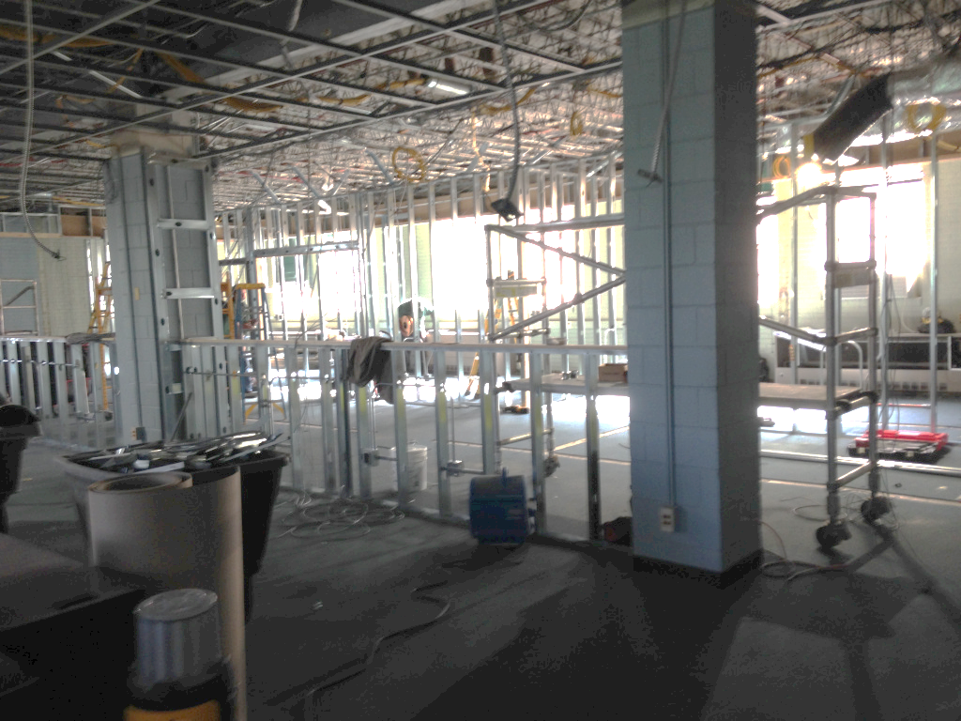
Changes…
The Provost’s office and College Dean’s office provided one-time funds to improve the environment.
Physical environment changes were accompanied by a name change in the program and changes in messaging.
Construction took place over Summer 2020, along with campus-wide changes to all web pages that referenced the program and center.
SEP contacts brought together a team to design the new space, and SEP focus areas provided lenses through which the space was examined during design.

Slide 6
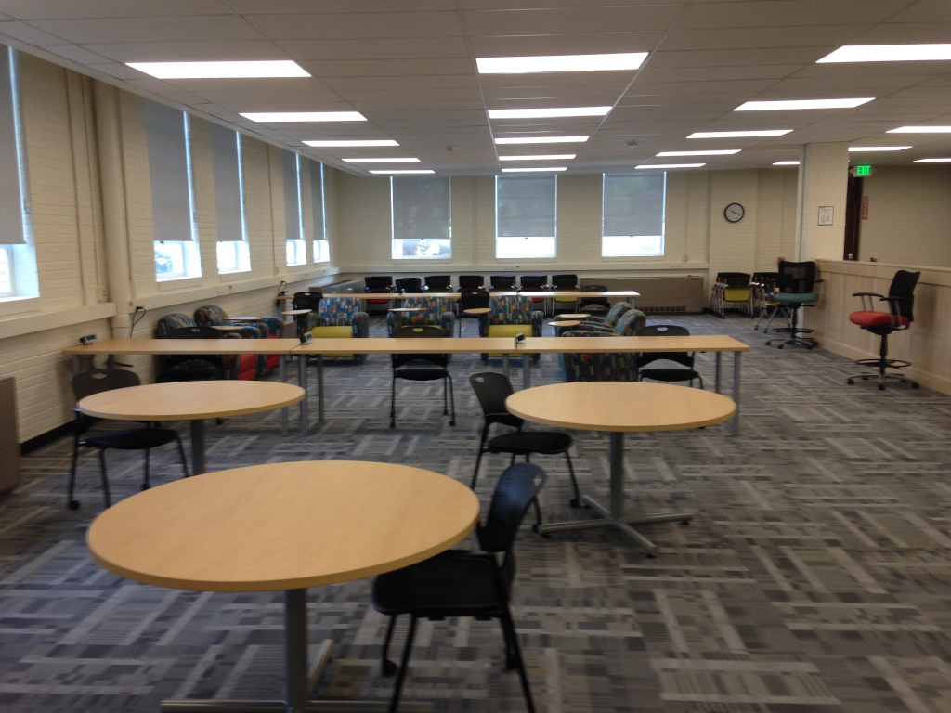
Results
The new environment is brighter, more open and inviting, less intimidating, and (we hope) will appeal to a more diverse student population. Laptops and tablets available for loan within the center.
Signage in the center focuses on our core Principles of Community, and on normalizing struggle and help-seeking.
The center name was also changed to The Precalculus Center. If students verbalize “Precalculus ____” or “____ Precalculus”, that’s a different conversation (the material is the adversary, not the program), and we become allies and partners.

Slide 7
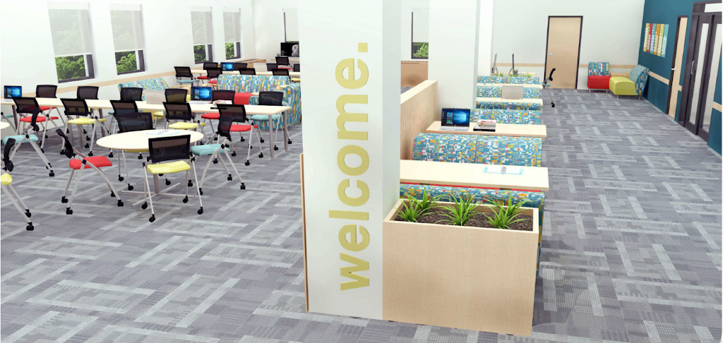
Data Collection
Message-IT survey with an artifact consisting of an image of the new space and the new signage.
Unfortunately, we do not have similar data on the previous facility for comparison…

Slide 8
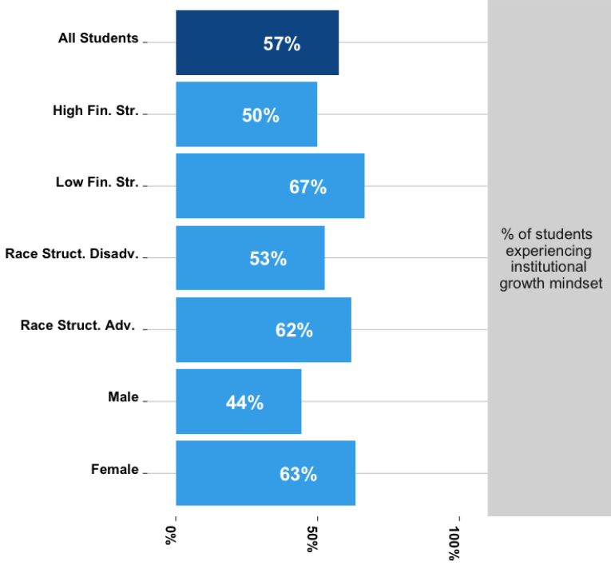
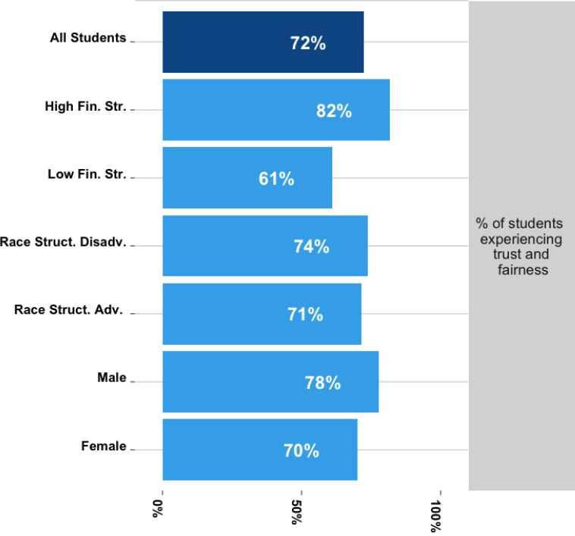
Growth mindset, trust and fairness

Slide 9
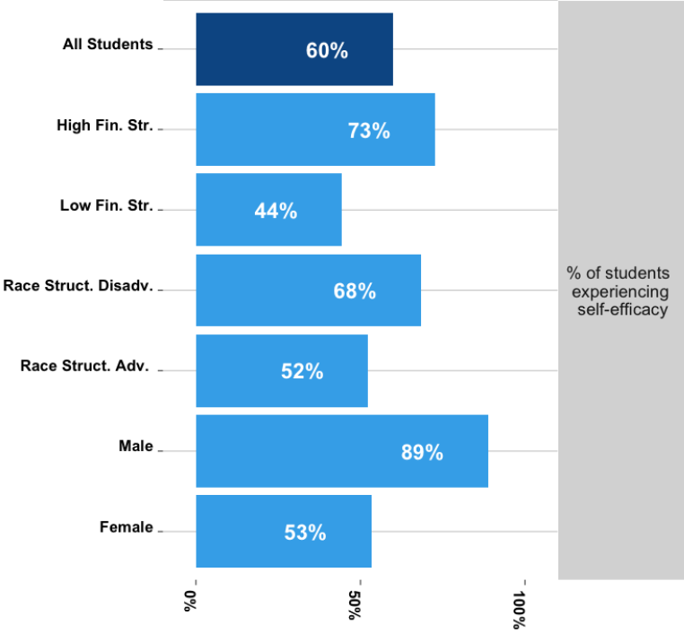
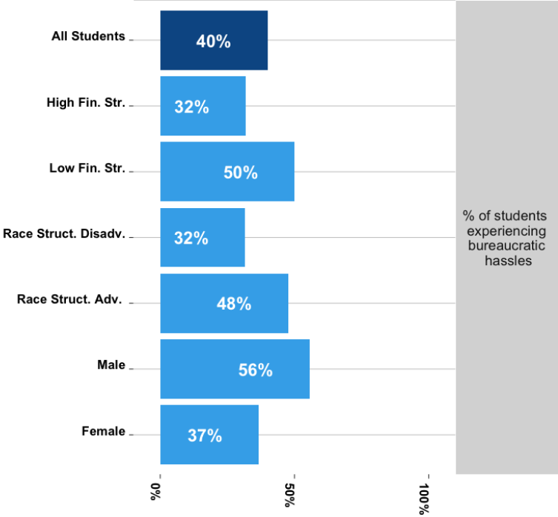
Self-efficacy, bureaucratic hassles

Slide 10
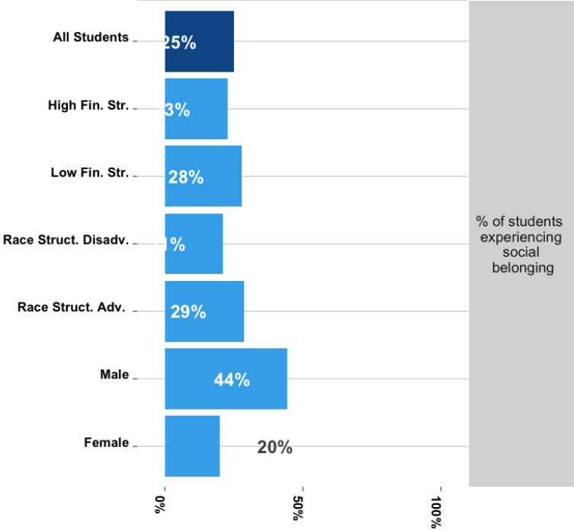
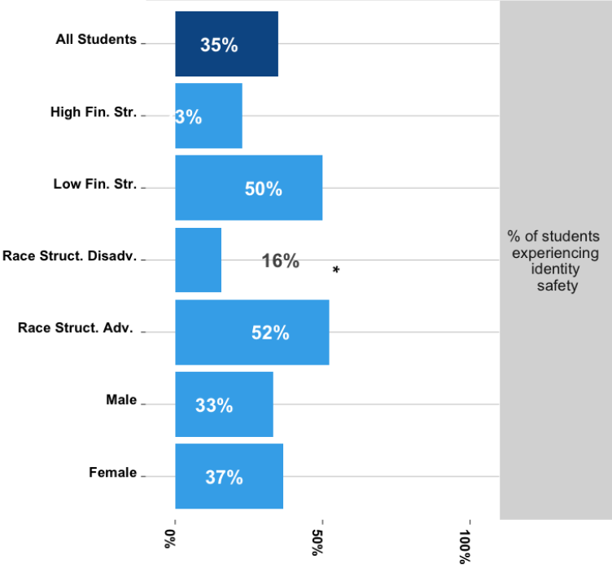
Social belonging, identity safety

Slide 11
Future Plans
Add signage focused on diverse representation (to make the space warmer and more inviting, and to showcase the diversity inherent to mathematics – the “universal language”).
Make deeper changes to how our online program is delivered to better align how our online resources are perceived with how our physical space is perceived (many more student-hours are spent in the online materials).

