Slide 1

Mathematical modeling of biological events and cell-cell communication
Steve Benoit
Department of Mathematics
Colorado State University
This program is based upon collaborative work supported by a National Science Foundation Grant No. 0841259; Colorado State University, Thomas Chen, Principal Investigator, Michael A. de Miranda and Stuart Tobet Co-Principal Investigators. Any opinions, findings, conclusions or recommendations expressed in this material are those of the author(s) and do not necessarily reflect the views of the National Science Foundation.

Slide 2
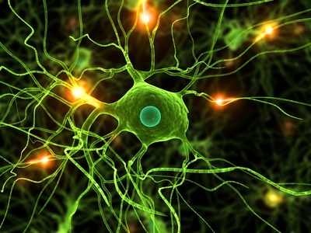
Mathematical Models in Biology
EXPERIMENT
Data
Model
Biological System

Slide 3
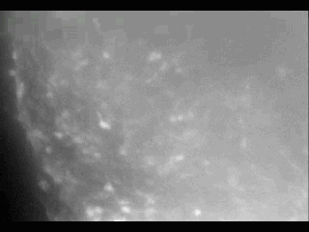

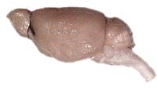
The Biological System

Slide 4

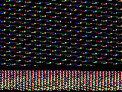
History: “Top-Down” Models
Continuum model of cell concentration
(Keller, Segel -1971)

Slide 5
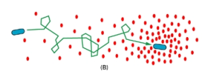
History: “Top-Down” Models
Continuum model of cell concentration
(Keller & Segel -1971)
Random walk with bias
(Alt – 1980)

Slide 6
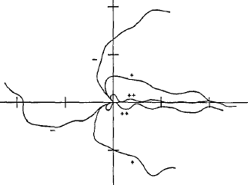
History: “Top-Down” Models
Continuum model of cell concentration
(Keller & Segel -1971)
Random walk with bias
(Alt – 1980)
Stochastic model
(Tranquillo – 1988)

Slide 7
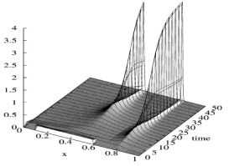
History: “Top-Down” Models
Continuum model of cell concentration
(Keller & Segel -1971)
Random walk with bias
(Alt – 1980)
Stochastic model
(Tranquillo – 1988)
Hyperbolic continuum model
(Hillen & Stevens - 2000)

Slide 8
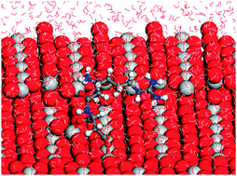
History: “Bottom-Up” Models
Molecular dymanics models

Slide 9
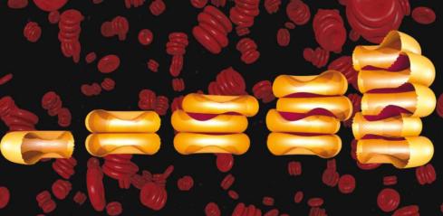
History: “Bottom-Up” Models
Molecular dymanics models
Membrane models

Slide 10
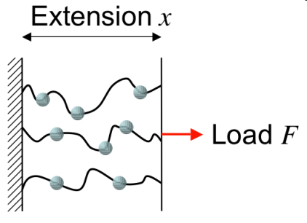
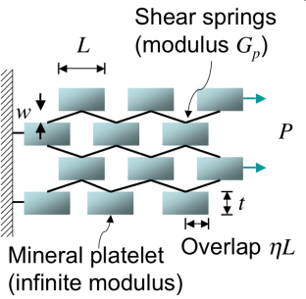
History: “Bottom-Up” Models
Molecular dymanics models
Membrane models
Cytoskeleton models

Slide 11
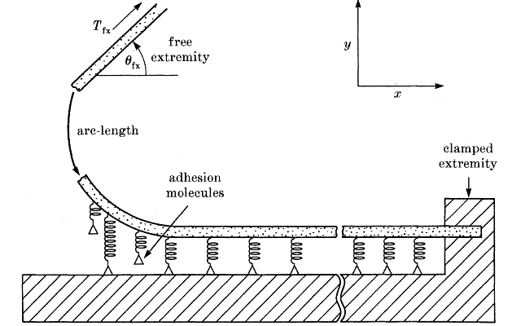
History: “Bottom-Up” Models
Molecular dymanics models
Membrane models
Cytoskeleton models
Adhesion modulation models

Slide 12
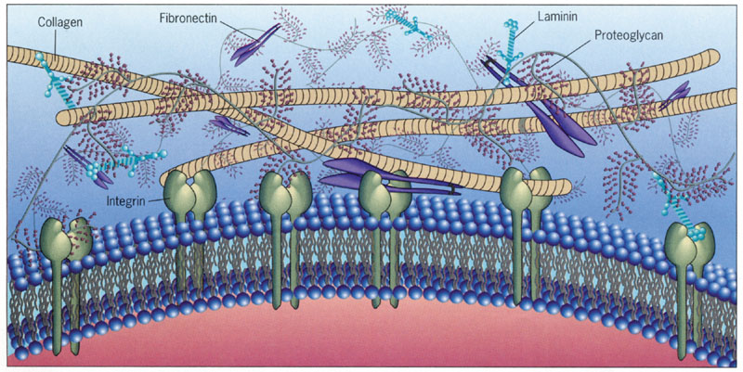
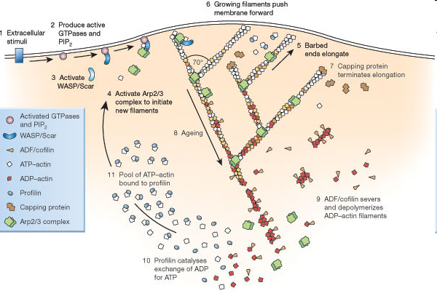
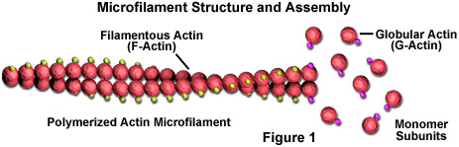
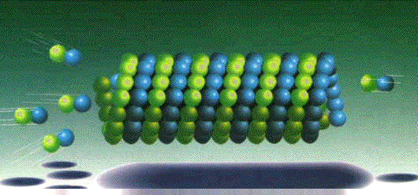
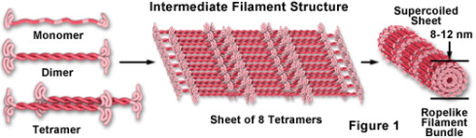
The Challenge…
No model can capture the complexity of the biological system

Slide 13

The Challenge…
The goal is to capture critical behaviors while ignoring the rest:
“Make everything as simple as possible but no simpler.”
- A. Einstein
How do we know what to ignore?
Experiment and data…

Slide 14
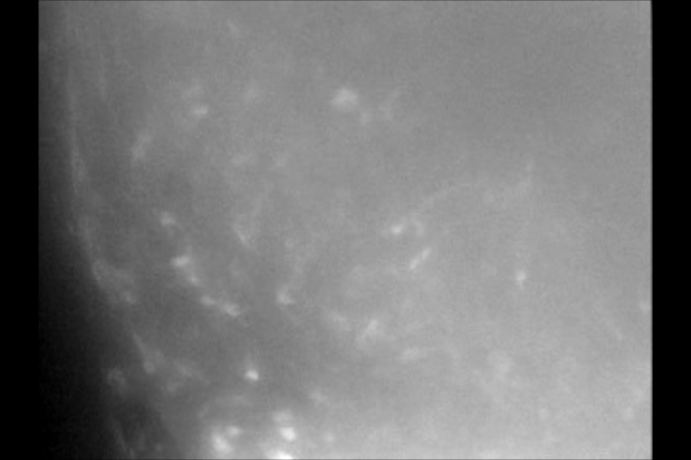
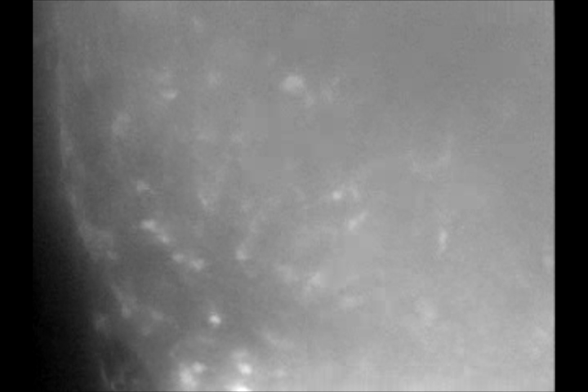

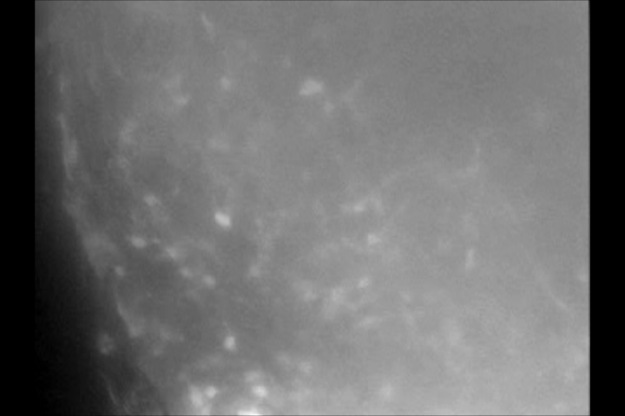
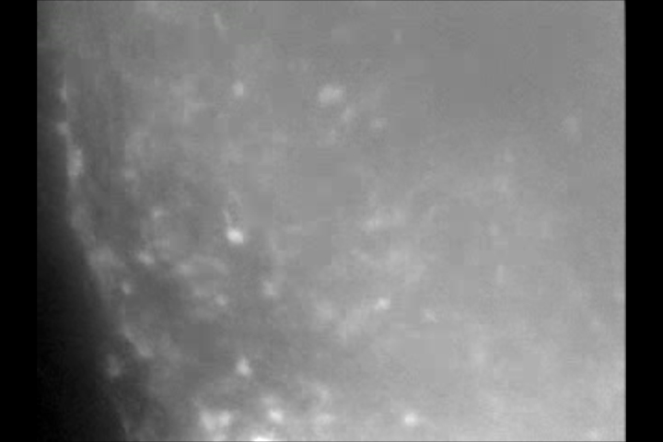
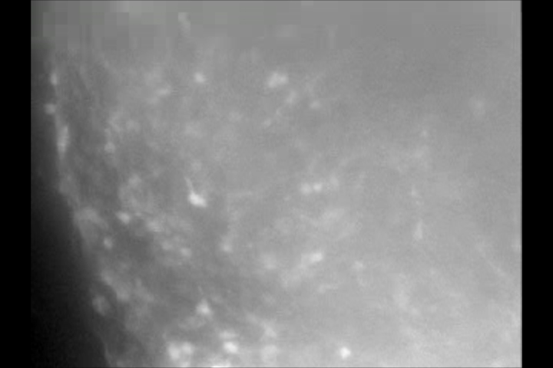
Data Gathering Process
Extract individual frames from videos
Compensate for global motion

Slide 15
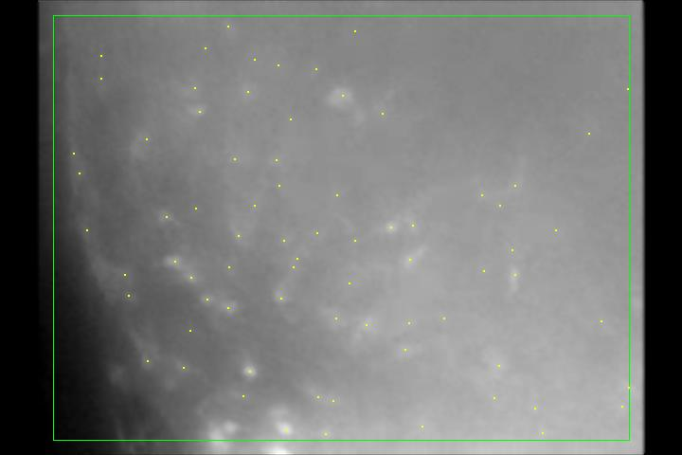
Data Gathering Process
Extract individual frames from videos
Compensate for global motion
Identify cells by finding local maxima

Slide 16
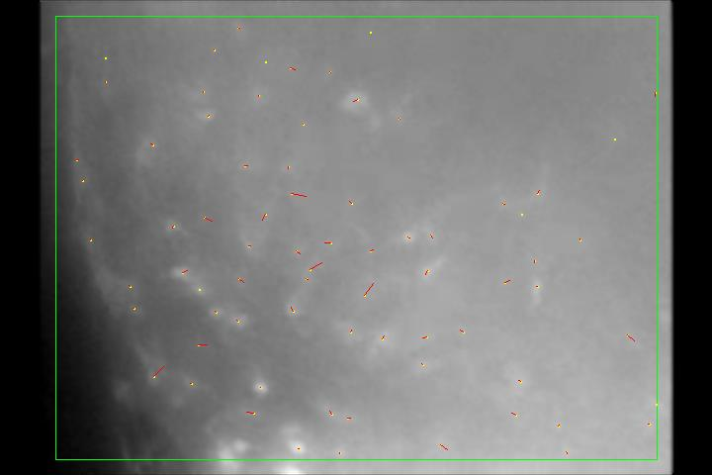
Data Gathering Process
Extract individual frames from videos
Compensate for global motion
Identify cells by finding local maxima
Correlate cell positions between frames

Slide 17
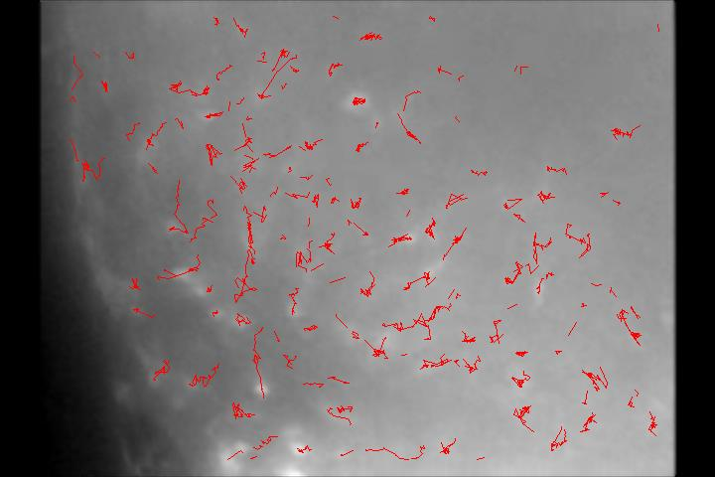
Data Gathering Process
Extract individual frames from videos
Compensate for global motion
Identify cells by finding local maxima
Correlate cell positions between frames
Construct trajectories

Slide 18

Data Gathering Process
Trajectories overlaid on motion-compensated video:

Slide 19
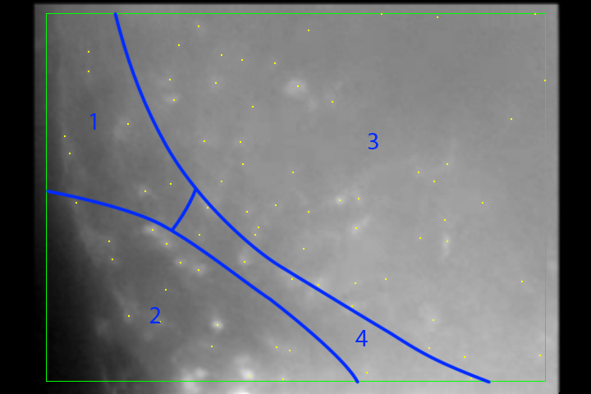
Data Gathering Process
Extract individual frames from videos
Compensate for global motion
Identify cells by finding local maxima
Correlate cell positions between frames
Construct trajectories
Categorize by region within the domain

Slide 20
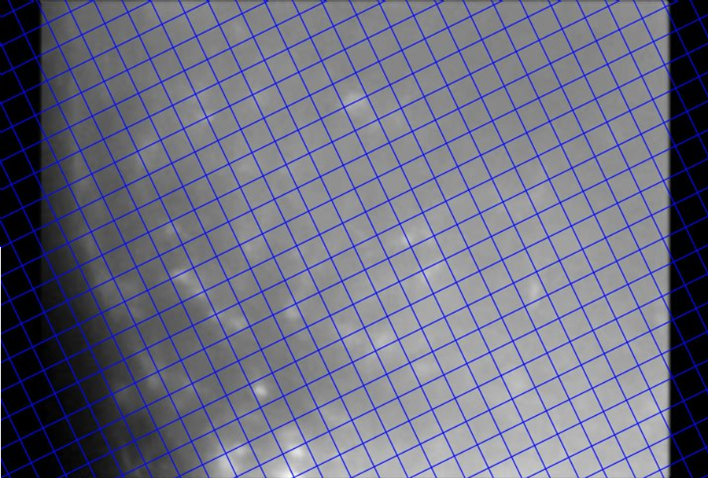
Motion Analysis
Add coordinate system based on tissue orientation

Slide 21
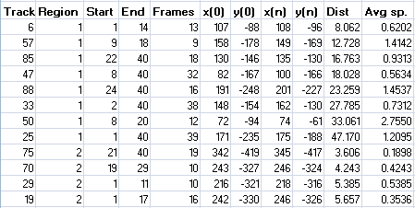
Motion Analysis
Add coordinate system based on tissue orientation
Trajectory start, end frames, distance, avg. speed

Slide 22
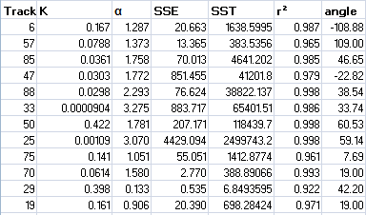
Motion Analysis
Add coordinate system based on tissue orientation
Trajectory start, end frames, distance, avg. speed
Avg. direction (angle), diffusion model parameters

Slide 23
Motion Analysis
Add coordinate system based on tissue orientation
Trajectory start, end frames, distance, avg. speed
Avg. direction (angle), diffusion model parameters
Analysis groups:
    By region
    By length of trajectory (long vs. short)
    By average speed (slow vs. fast)
    By age (start frame)

Slide 24
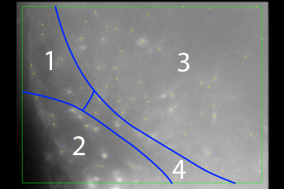
Analysis Results
Distribution of direction of motion:
Whole population:
Distance > 15:
Avg. speed > 0.9:
Region 1
Region 2
Region 3
Region 4

Slide 25
Analysis Results
Correlation of direction with speed and distance:
Region 1
Region 3
Region 2
Region 4

Slide 26
Analysis Results
Correlation of speed with cell age (start frame):
Region 1
Region 3
Region 2
Region 4

Slide 27
Interpretation
Strong correlation of motion direction with region in regions 1 and 4, weaker in 2, and weaker still in 3.
Long and fast motions exhibit a preferred direction, which is most pronounced in regions 1 and 4.
Conclusion: Cell motion is being directed by a signaling mechanism in regions 1 and 4

Slide 28
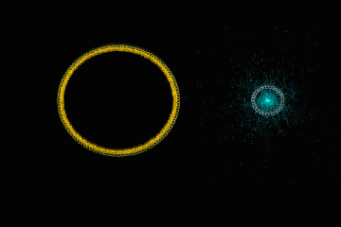
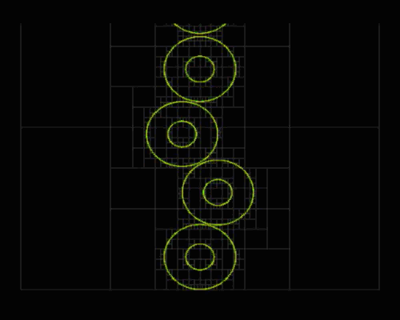
Model Components
Membrane
Cytoskeleton / Chemotaxis
Interactions

Slide 29
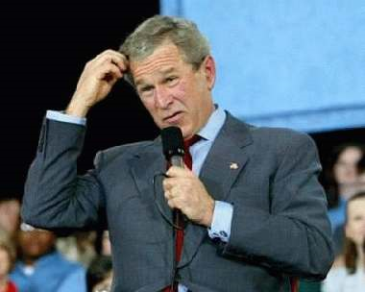
Questions?

Slide 30
Acknowledgements
Colorado State University
Tom Chen
Stuart Tobet
The Tobet Lab
Matt Stratton
Krystle Frahm
Cheryl Hartshorn
University of Ljubljana
Gregor Majdič
Drago Strle
Jožef Stefan Institute
Primož Ziherl

