Slide 1
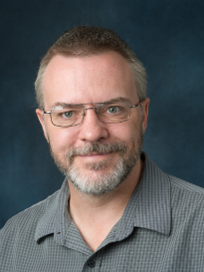
Precalculus Program
Steve Benoit Associate Professor and Precalculus Program Co-Director steve.benoit@colostate.edu ---- (970) 491-0549 November 8, 2021

Slide 2
Outline of Talk
Courses and program structure
Integrated math placement
Curriculum and mastery
Program operation
Outcomes
Our future plans
Q & A

Slide 3
Courses and Program Structure

Slide 4
Suite of Precalculus Courses
Five courses, each 1 credit
Courses have prerequisite relationships, but concurrent enrollment is allowed
Students can register for just one, all five, anything in between (respecting prereqs)

Slide 5
Suite of Precalculus Courses
MATH 117 Linear Functions
Piecewise, Abs. Value Functions
Quadratic Functions
Systems of Equations
MATH 125 Trigonometric Functions
Laws of Sines and Cosines
Unit Circle & Radian Measure
Periodic Functions
MATH 118 Polynomial Functions
Rational Functions
Radical and Root Functions
Power Functions
MATH 126 Inverse Trigonometric Functions
Fundamental Identities
Sum & Difference Identities
Double & Half Angle Identities
MATH 124 Functions and Rates of Change
Exponential Functions
Logarithms
Exponential and Logarithmic Models

Slide 6
Suite of Precalculus Courses
Several flavors of Calculus, each with a set of prerequisite Precalculus courses

Slide 7
Suite of Precalculus Courses
Calculus in Management Sciences (Business Calculus)
Several flavors of Calculus, each with a set of prerequisite Precalculus courses

Slide 8
Suite of Precalculus Courses
Calculus in Management Sciences (Business Calculus)
Calculus for Biological Scientists I
Several flavors of Calculus, each with a set of prerequisite Precalculus courses

Slide 9
Suite of Precalculus Courses
Calculus in Management Sciences (Business Calculus)
Calculus for Biological Scientists I
Mathematics for Computational
Science I (Calculus for CS)
Calculus for Physical Scientists I (Engineering Calculus)
Several flavors of Calculus, each with a set of prerequisite Precalculus courses

Slide 10
Suite of Precalculus Courses
Degree programs on campus that do not require Calculus can choose the Precalculus courses their students need

Slide 11
Suite of Precalculus Courses
Construction Management
Degree programs on campus that do not require Calculus can choose the Precalculus courses their students need

Slide 12
Suite of Precalculus Courses
Construction Management
Psychology
Degree programs on campus that do not require Calculus can choose the Precalculus courses their students need

Slide 13
Suite of Precalculus Courses
Construction Management
Psychology
Landscape Architecture
Degree programs on campus that do not require Calculus can choose the Precalculus courses their students need

Slide 14
Integrated Math Placement

Slide 15
Math Placement
A “My Math Plan” web site to tell students what courses they need and when they should plan to complete them to stay on track for their major(s) of interest.
A custom Math Placement Tool that aligns with the five-course structure.
A suite of no-cost tutorials that earn placement but not course credit.
Course challenge exams to earn credit by exam.

Slide 16
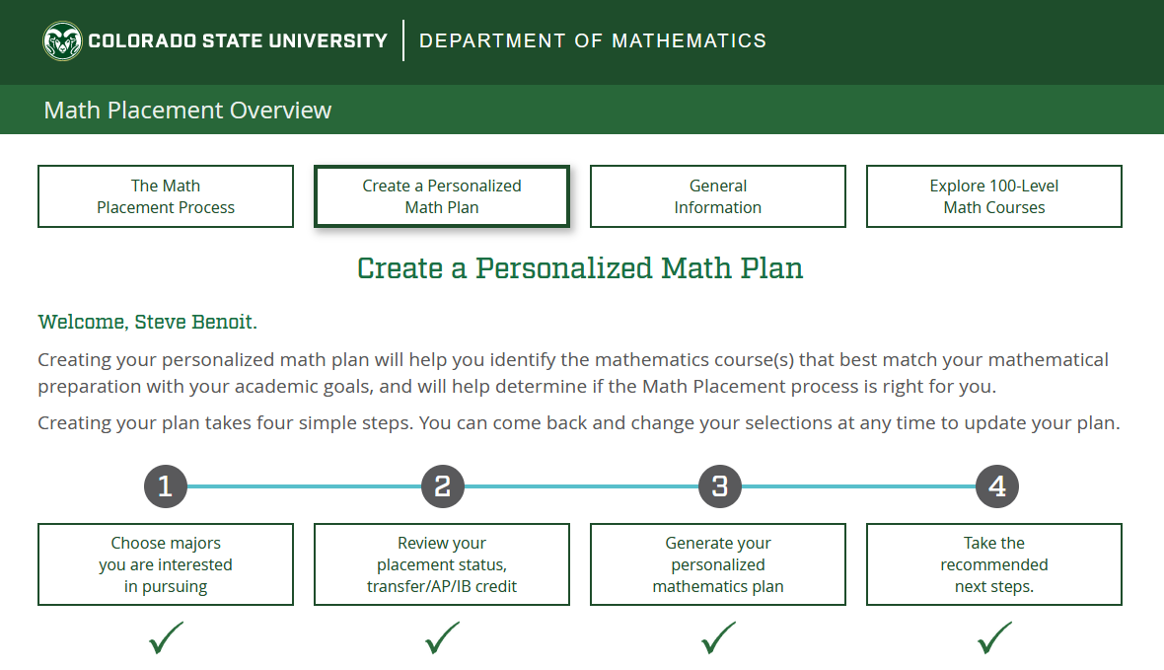
Math Plan

Slide 17
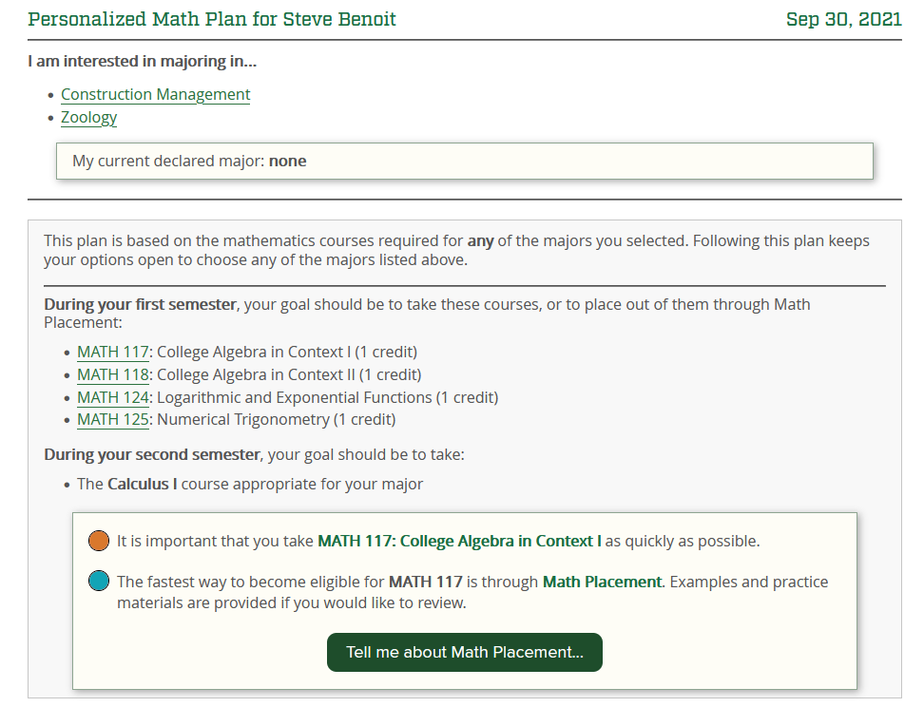
Math Plan

Slide 18
Math Placement Tool
Students can place into the first course, or place out of any sequence of courses.
To place out of course X, student must place out of all prerequisite courses too.
Placement out of a course satisfies prerequisites as if the course had been completed.

Slide 19
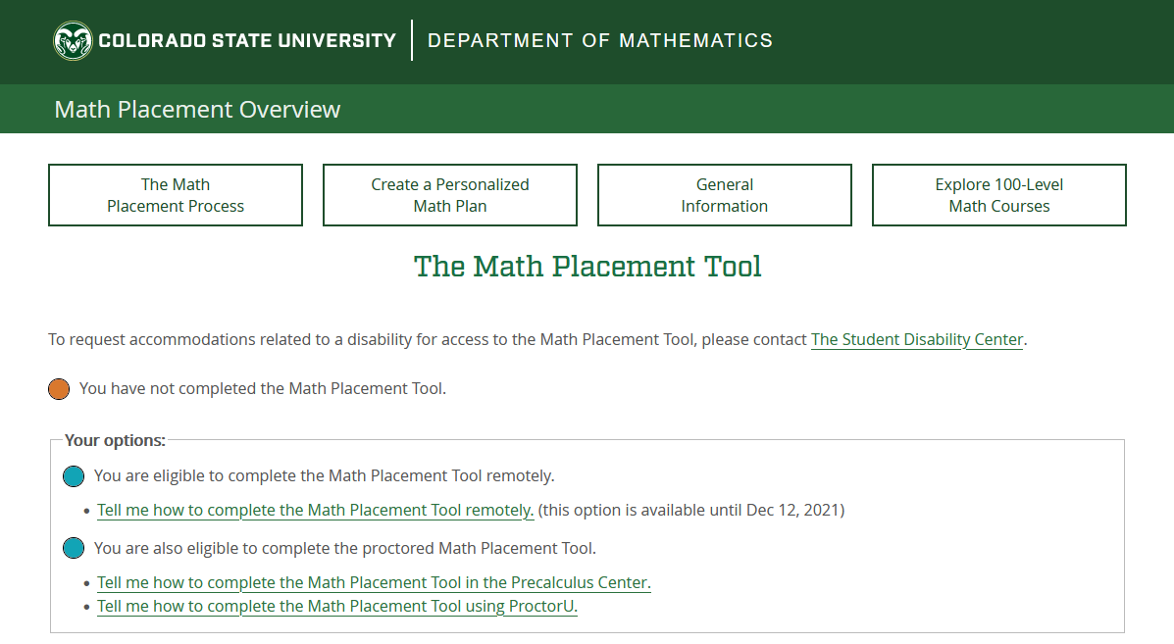
Math Placement Tool

Slide 20
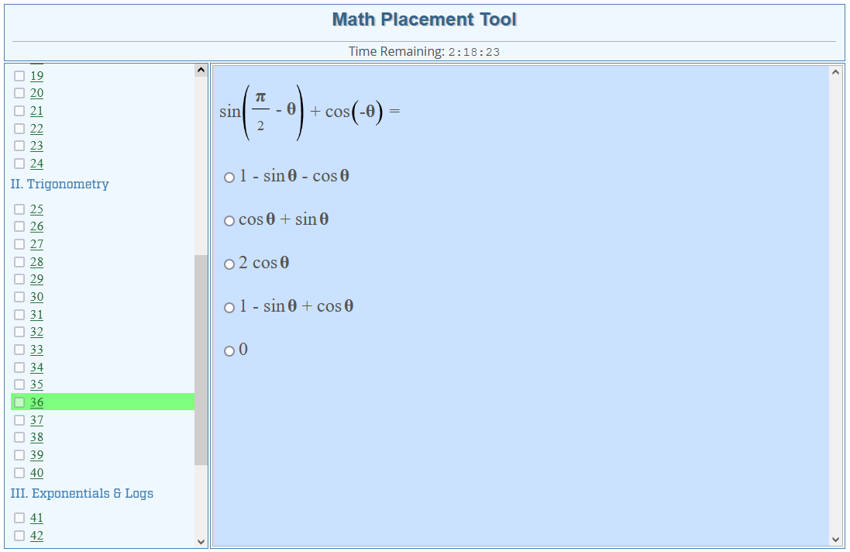
Math Placement Tool
50-item assessment, delivered online, with randomized items.
Incoming students can complete tool from home before arriving on campus.
All students have two total attempts.
Review materials are provided and review is encouraged.

Slide 21
Math Placement Tutorials
No-cost online tutorials with proctored final exams are available to improve placement results (they carry no credit and do not require registration)
Tutorials are free to any student after their Math Placement Tool, before they arrive on campus – which tutorial is available depends on current placement results.
Entry Level Mathematics Tutorial earns placement into first Algebra course.
Every Precalculus course has a corresponding Precalculus Tutorial to earn placement out of the corresponding course.
Tutorials use same curricular materials as the actual courses, and same final exam.
Goal is to get students Calculus-ready or ready for other courses with Precalculus prerequisites (Chemistry, Biology, etc.) before arriving on campus.

Slide 22
Challenge Exams
Students who need course credit can take a low-cost course challenge exam.
Final exam from the corresponding course, with 80% threshold to pass.
Student must be eligible to take course in order to challenge, and cannot be currently enrolled (it’s not a way to escape a low grade at the end of a course).

Slide 23
Curriculum and Mastery

Slide 24
Course Content
MATH 117: Linear functions, Absolute value and piecewise functions, Quadratic relations and functions, Systems of equations and inequalities
MATH 118: Polynomial functions, Rational functions, Radical functions, Power functions
MATH 124: Functions and inverses, Exponential functions, Logarithms, Modeling with exponential and logarithmic functions
MATH 125: Trigonometric functions, Laws of sines and cosines, The unit circle and radian measure, Periodic functions and applications
MATH 126: Inverse trigonometric functions, Fundamental identities, Sum and difference identities, Double- and half-angle identities

Slide 25
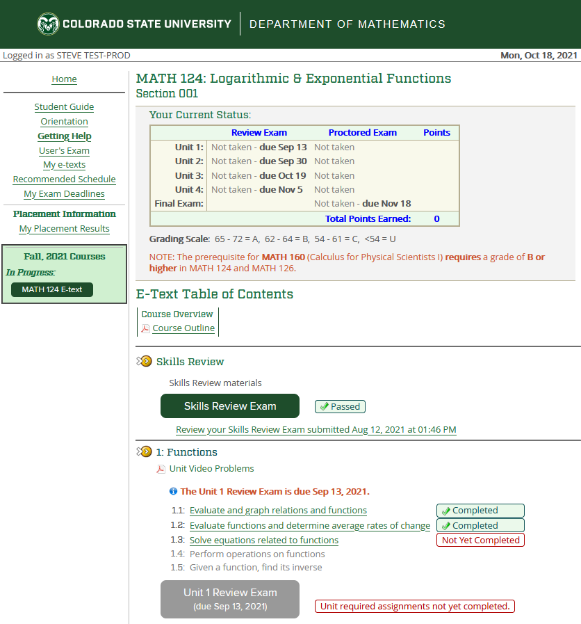
Course Delivery
Courses delivered through a web site that presents:
The student’s current score/status.
The “e-text” in outline format, with video lessons and examples, online assignments.
All exams the student has taken, with their answers, the correct answers, and detailed solutions.
How to get help.

Slide 26
Course Structure
Skills Review
Unit 1
Each course has 4 units of content.
Skills review exam before unit 1
Each unit has instructional content, short formative assessments.
Each unit culminates with a 10-item exam
Unproctored review exam
Proctored unit exam (counts toward grade)
Course culminates with comprehensive 20-item final exam.
Objective Assignments
Review Exam
Unit Exam
Unit 2
(same structure)
Unit 3
(same structure)
Unit 4
(same structure)
Cumulative Final Exam

Slide 27
Mastery Requirement
Skills Review
Unit 1
Mastery defined as 80% correct.
Skills review exam must be mastered to access Unit 1.
All objective assignments must be 100% correct to move to Unit Review Exam (unlimited re-tries)
Review Exam must be mastered to access proctored Unit Exam.
Unit exam must be mastered to access next unit’s Unit Review Exam.
All Units must be mastered to access Final Exam
Final exam must be mastered to complete course.
Objective Assignments
Review Exam
Unit Exam
Unit 2
(same structure)
Unit 3
(same structure)
Unit 4
(same structure)
Final Exam

Slide 28
Mastery Scoring and Grades
Skills Review
Unit 1
10 points possible per Unit Exam (8/10 required)
20 points possible on Final Exam (16/20 required)
3 points awarded for completion of Unit Review Exams by posted deadline (to keep students on schedule)
72 points total
“A” grade for 90% or higher (65+ points)
“B” grade for 86% to 90% (62-64 points)
“C” grade if all content mastered, but score is below 62 (minimum of 54 required to pass)
No “D” grades, “U” rather than “F” if not passing.
Objective Assignments
Review Exam
Unit Exam
Unit 2
(same structure)
Unit 3
(same structure)
Unit 4
(same structure)
Final Exam

Slide 29
Mastery Philosophy
Skills Review
Unit 1
Re-try exams without limit, only highest score counts.
All graded exams include detailed solutions.
To prevent rapid-fire retries on proctored Unit exams, a student who fails to master a Unit exam twice in a row has to re-master the unproctored Unit Review Exam (using same item bank) to earn 2 more tries on the Unit exam.
No limits to Final Exam attempts.
Students can continue to re-take Unit/Final exams after mastering Final Exam to try to raise point totals.
Objective Assignments
Review Exam
Unit Exam
Unit 2
(same structure)
Unit 3
(same structure)
Unit 4
(same structure)
Final Exam

Slide 30
Program Operation

Slide 31
Enrollment and Sections
Fall semester: ~3,400 students ~6,300 registrations
Spring semester: ~2,100 students ~3,500 registrations
Summer semester: ~600 students ~850 registrations
On-campus fully online sections (main section, 95% of students)
Late-start sections (beginning mid-semester)
Small face-to-face sections, requires dept. approval, for advisers to recommend
CSU Online (fully distance) sections – same course policies and delivery

Slide 32
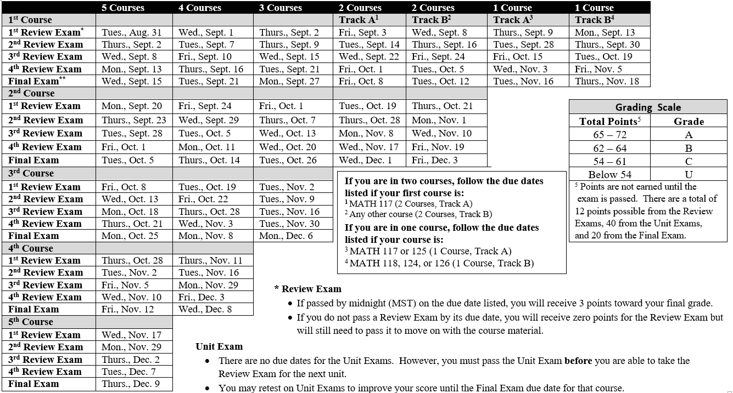
Course Tracks and Schedule

Slide 33
Precalculus Center Faculty & Staff
Steve Benoit
Co-Director
(Faculty)
Anita Pattison
Co-Director
(Admin Pro)
Assistant Director
(GTA)
Assistant Director
(GTA)
Office Staff
(Undergrads)
Testing Center Staff
(Undergrads)
Course Assistants
(Undergrads)

Slide 34
Precalculus Center Facility
Quiet Testing
Steve
Conference
Anita
Testing Center
Learning Center
Office
Res.
Lockers
Studio

Slide 35
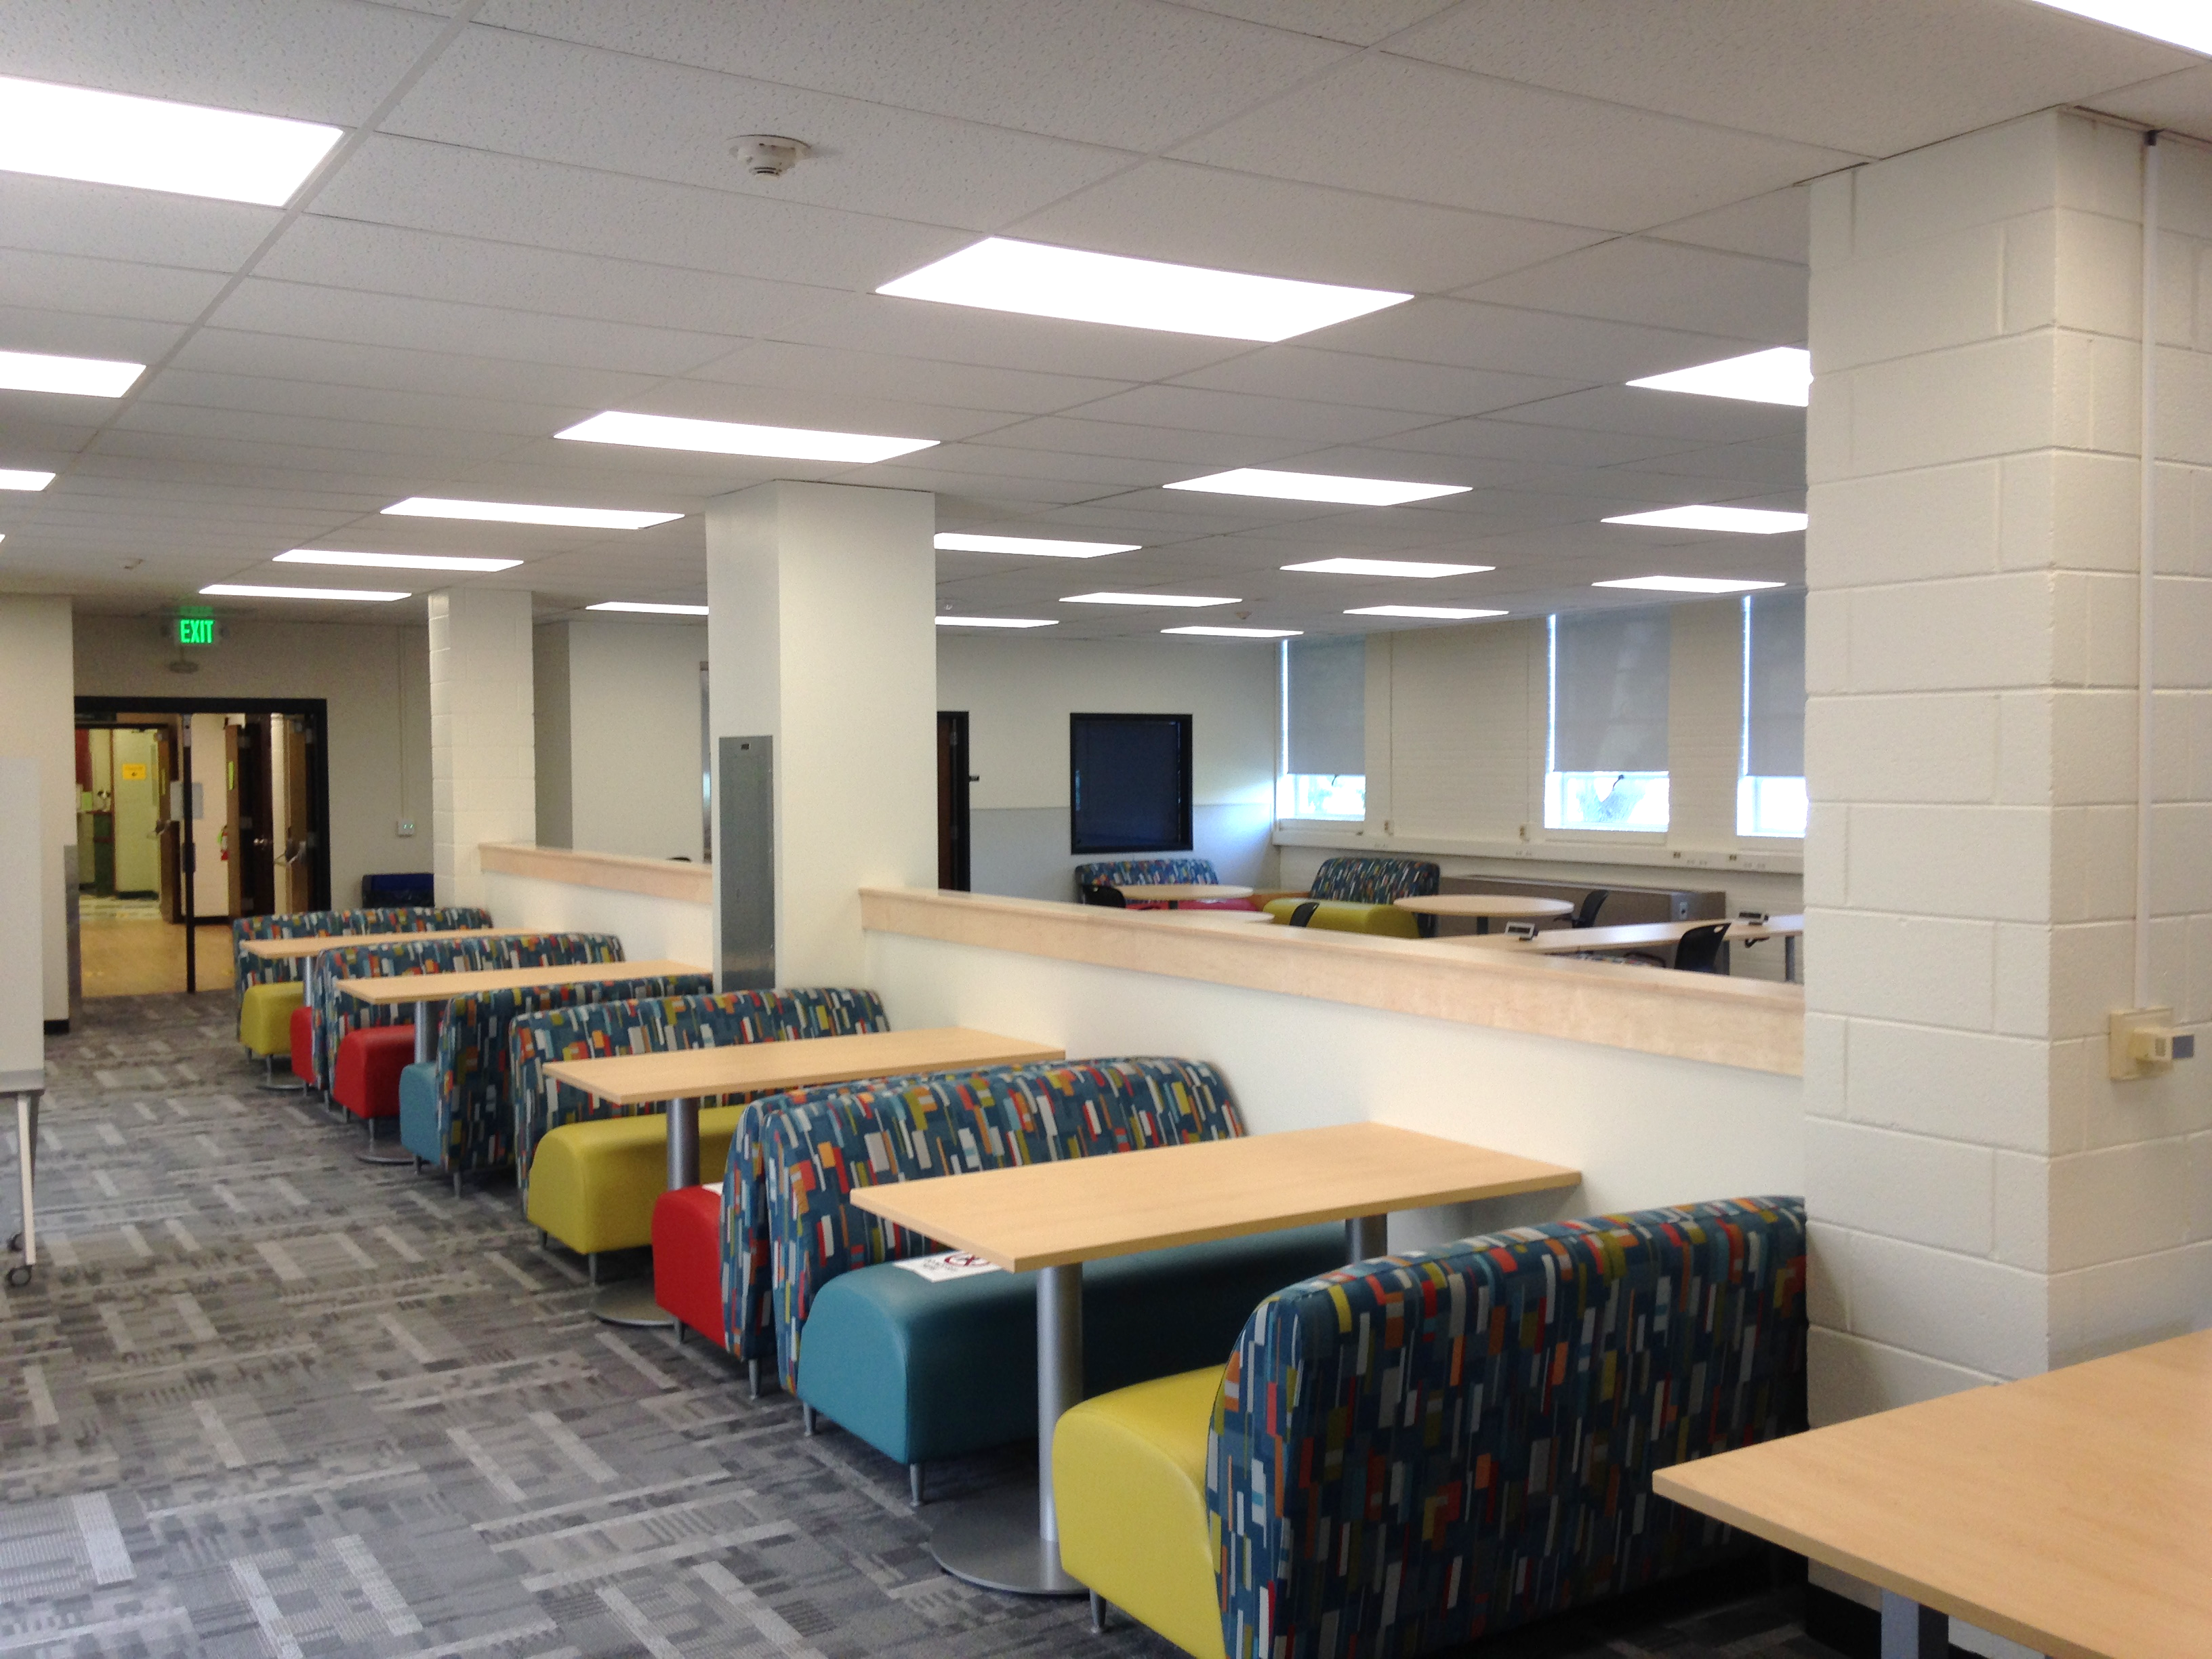
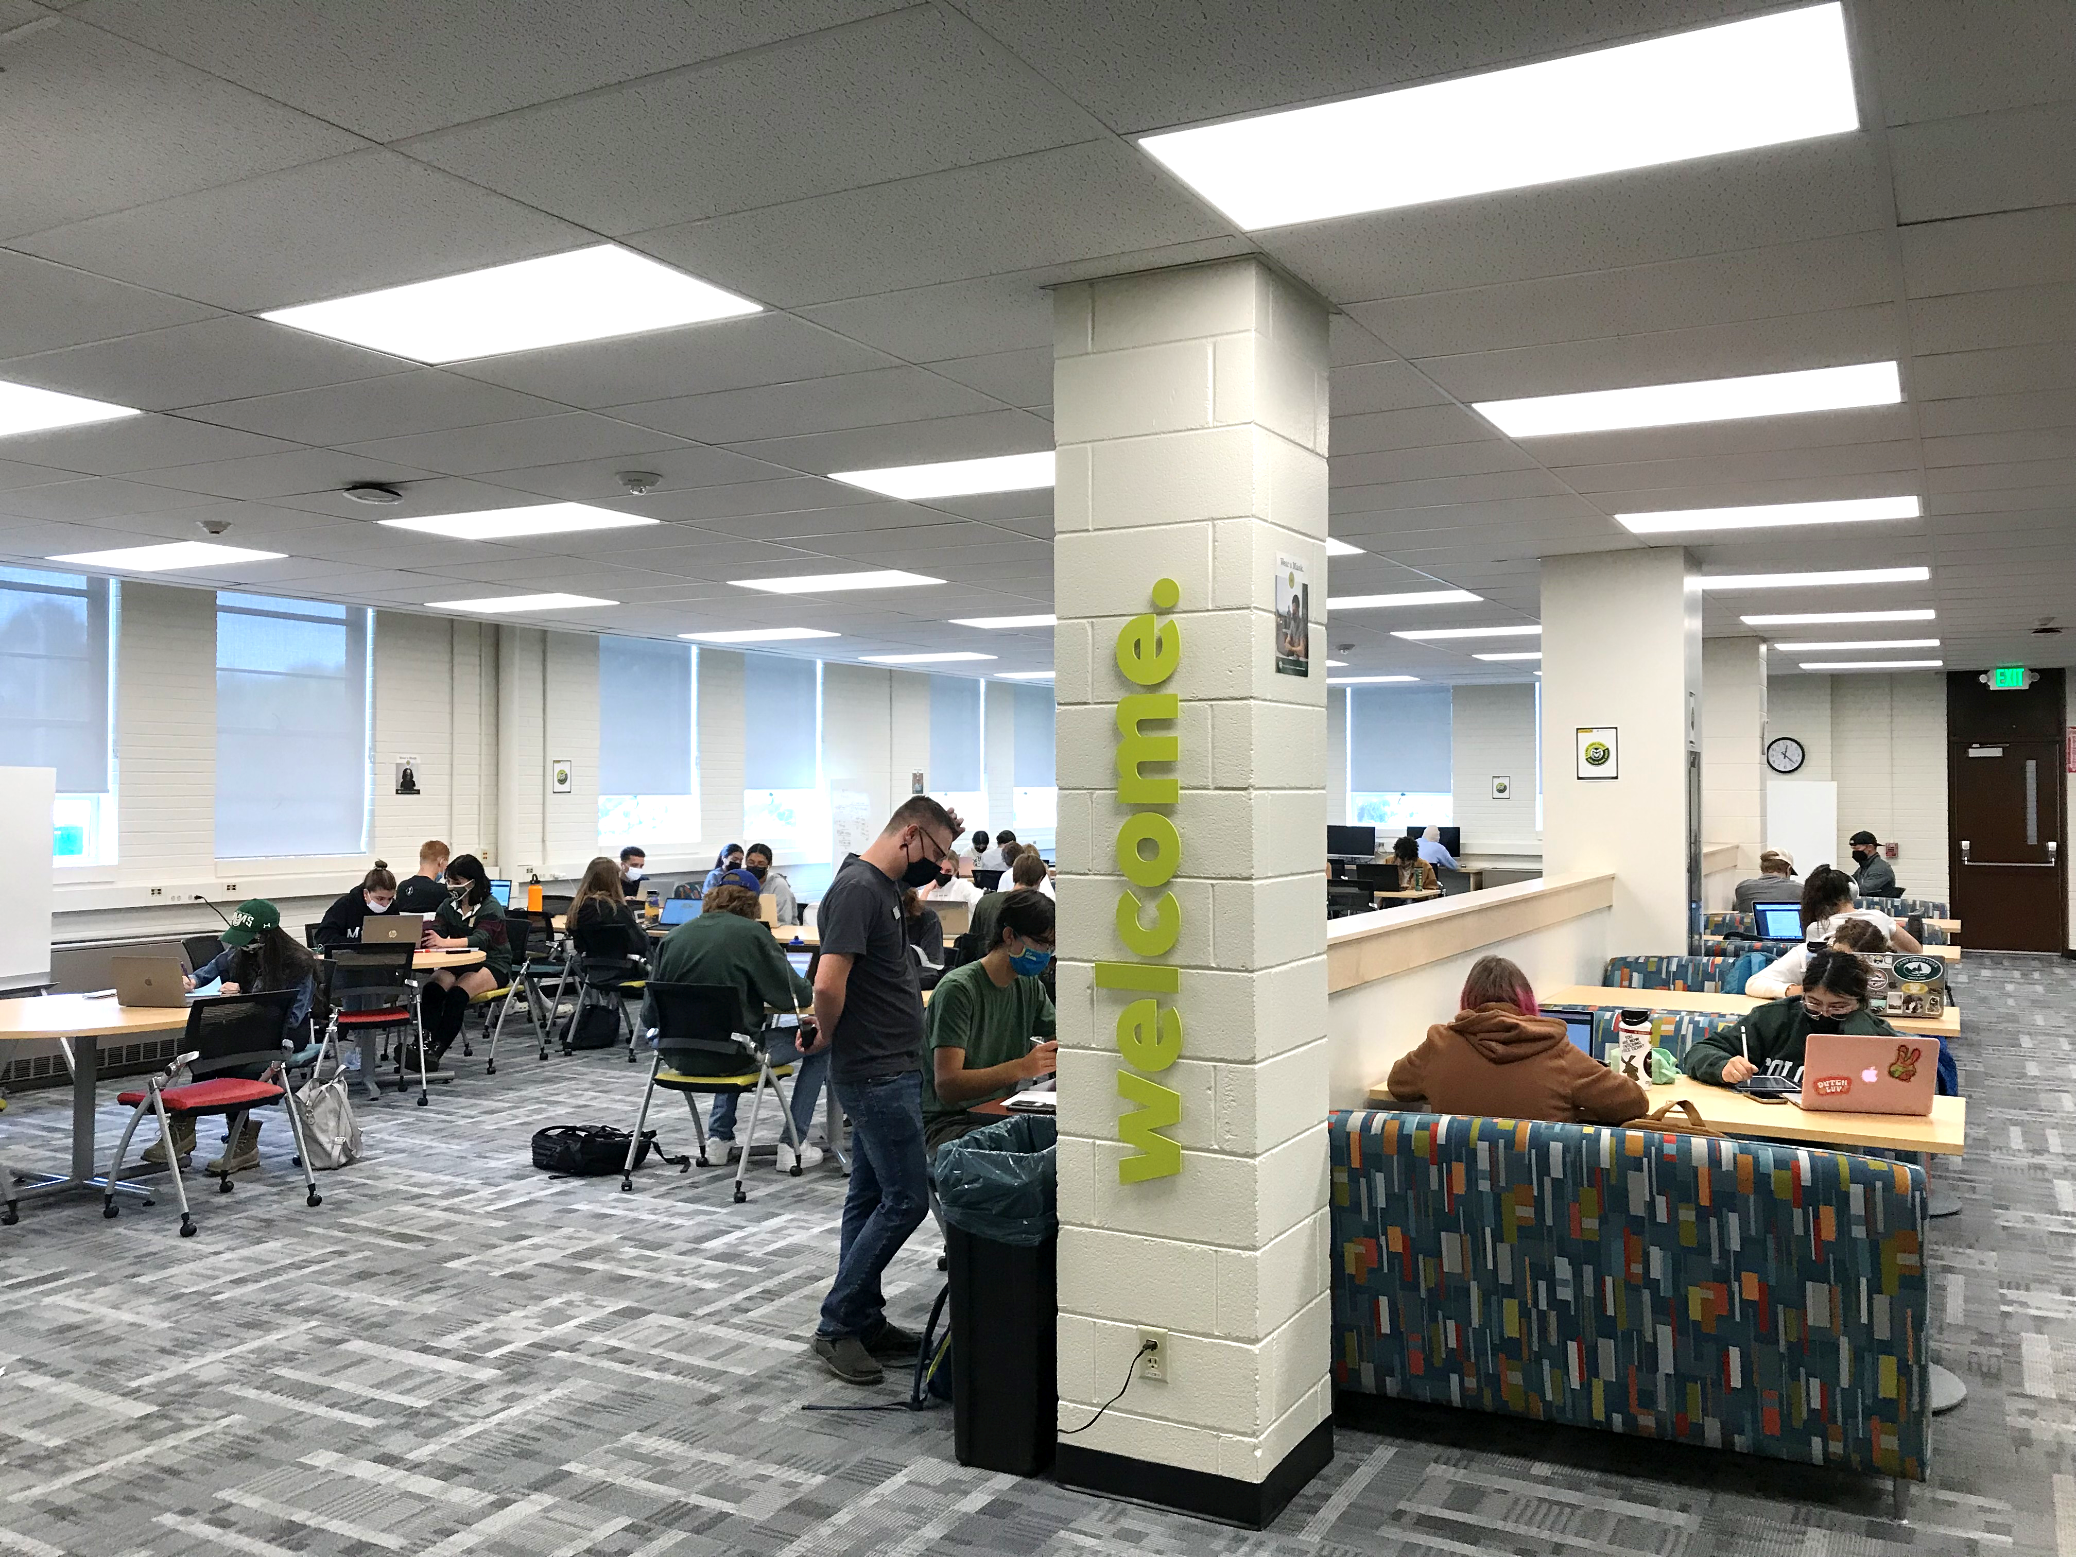
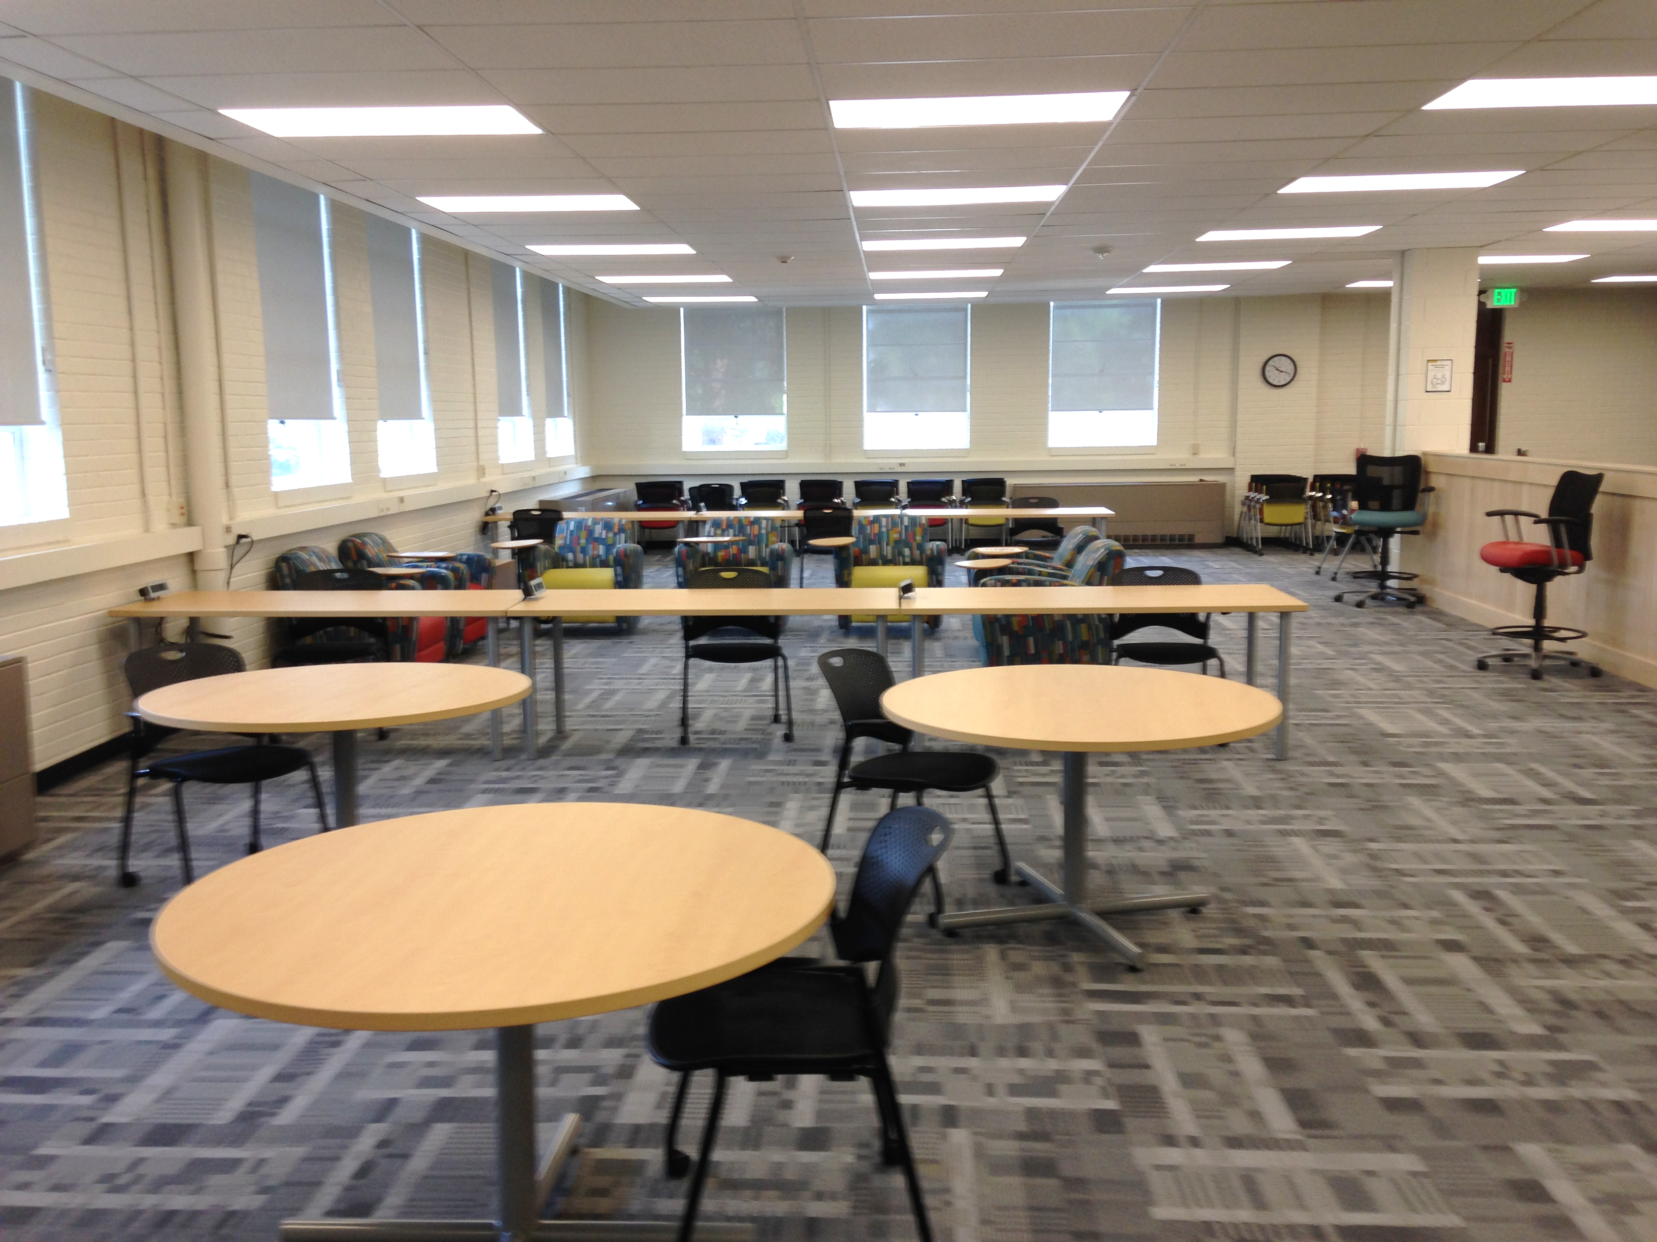
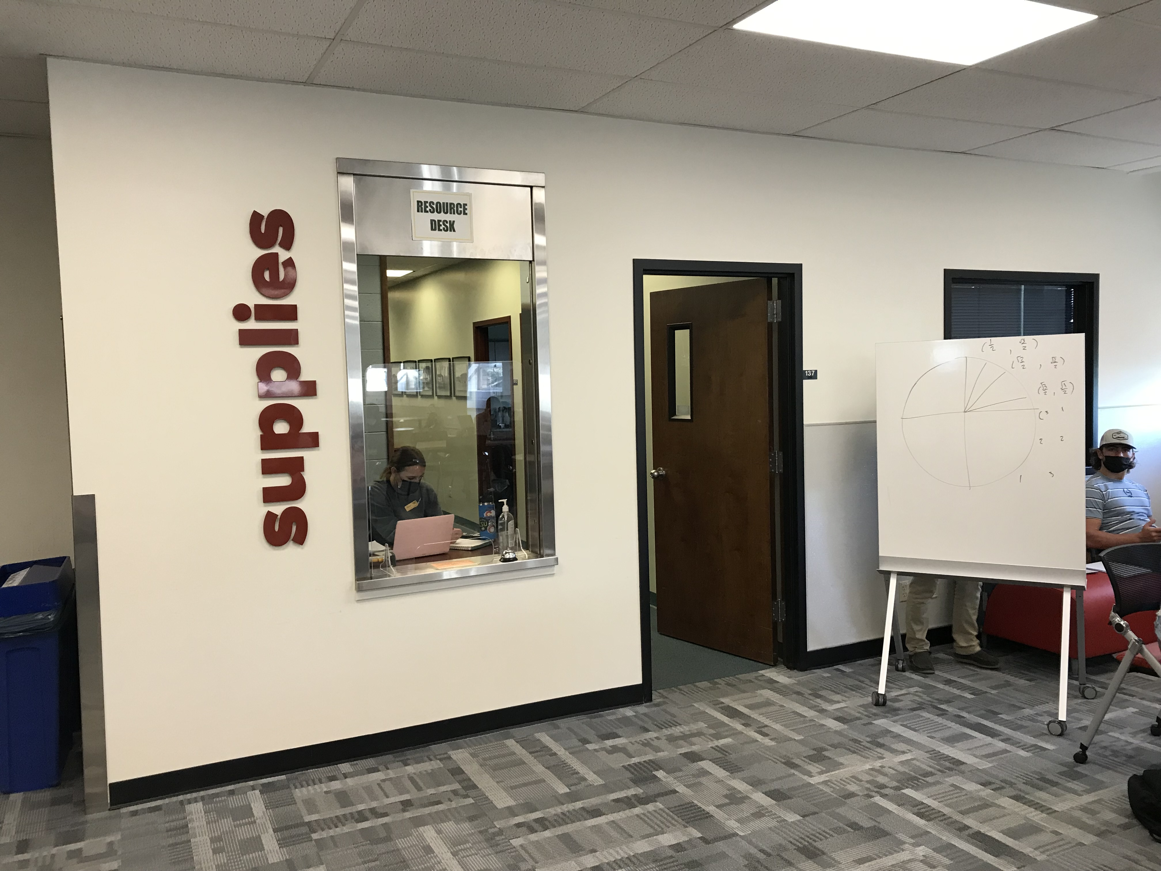
Tour: Learning Center

Slide 36
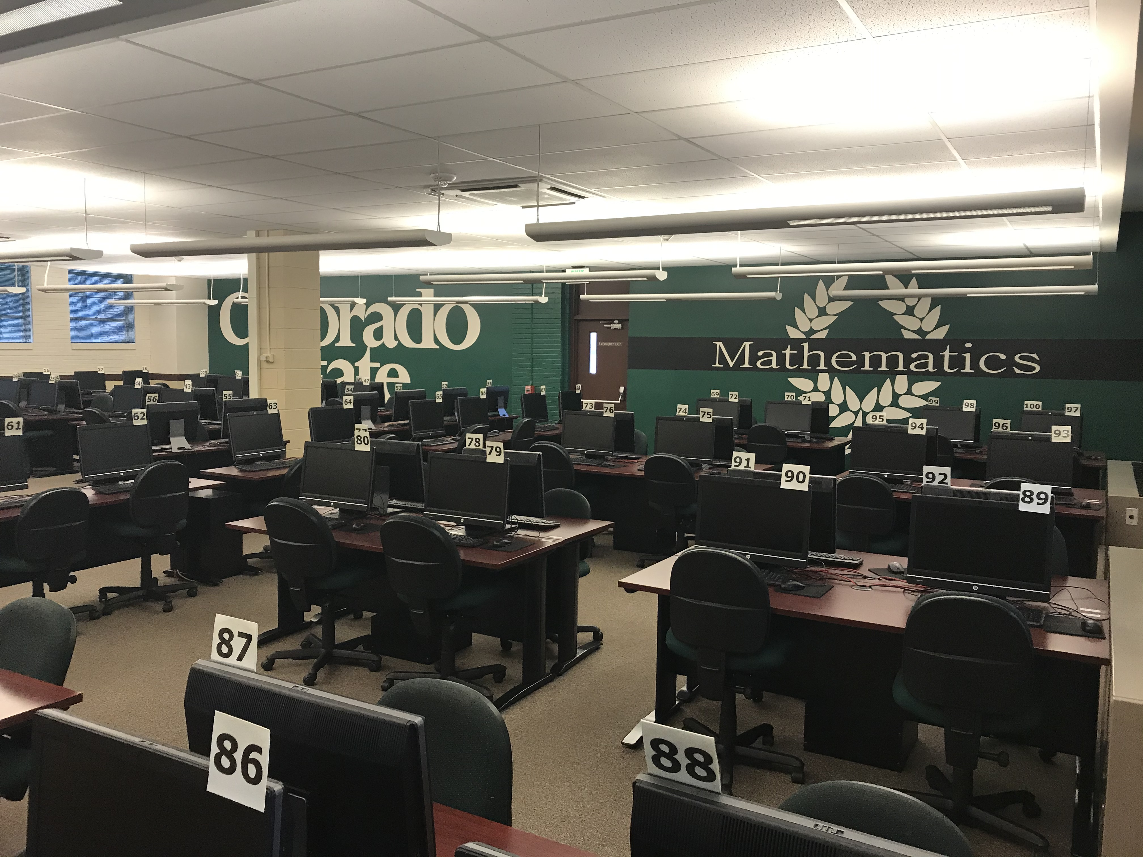
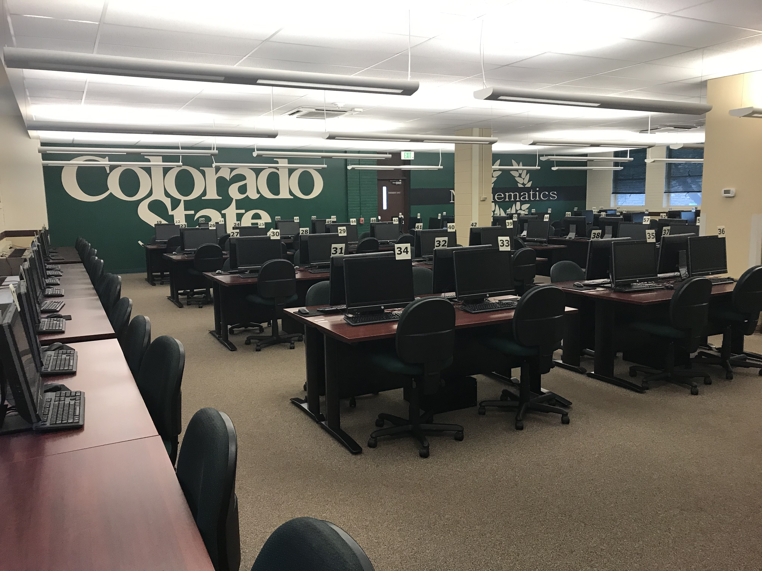
Tour: Testing Center

Slide 37
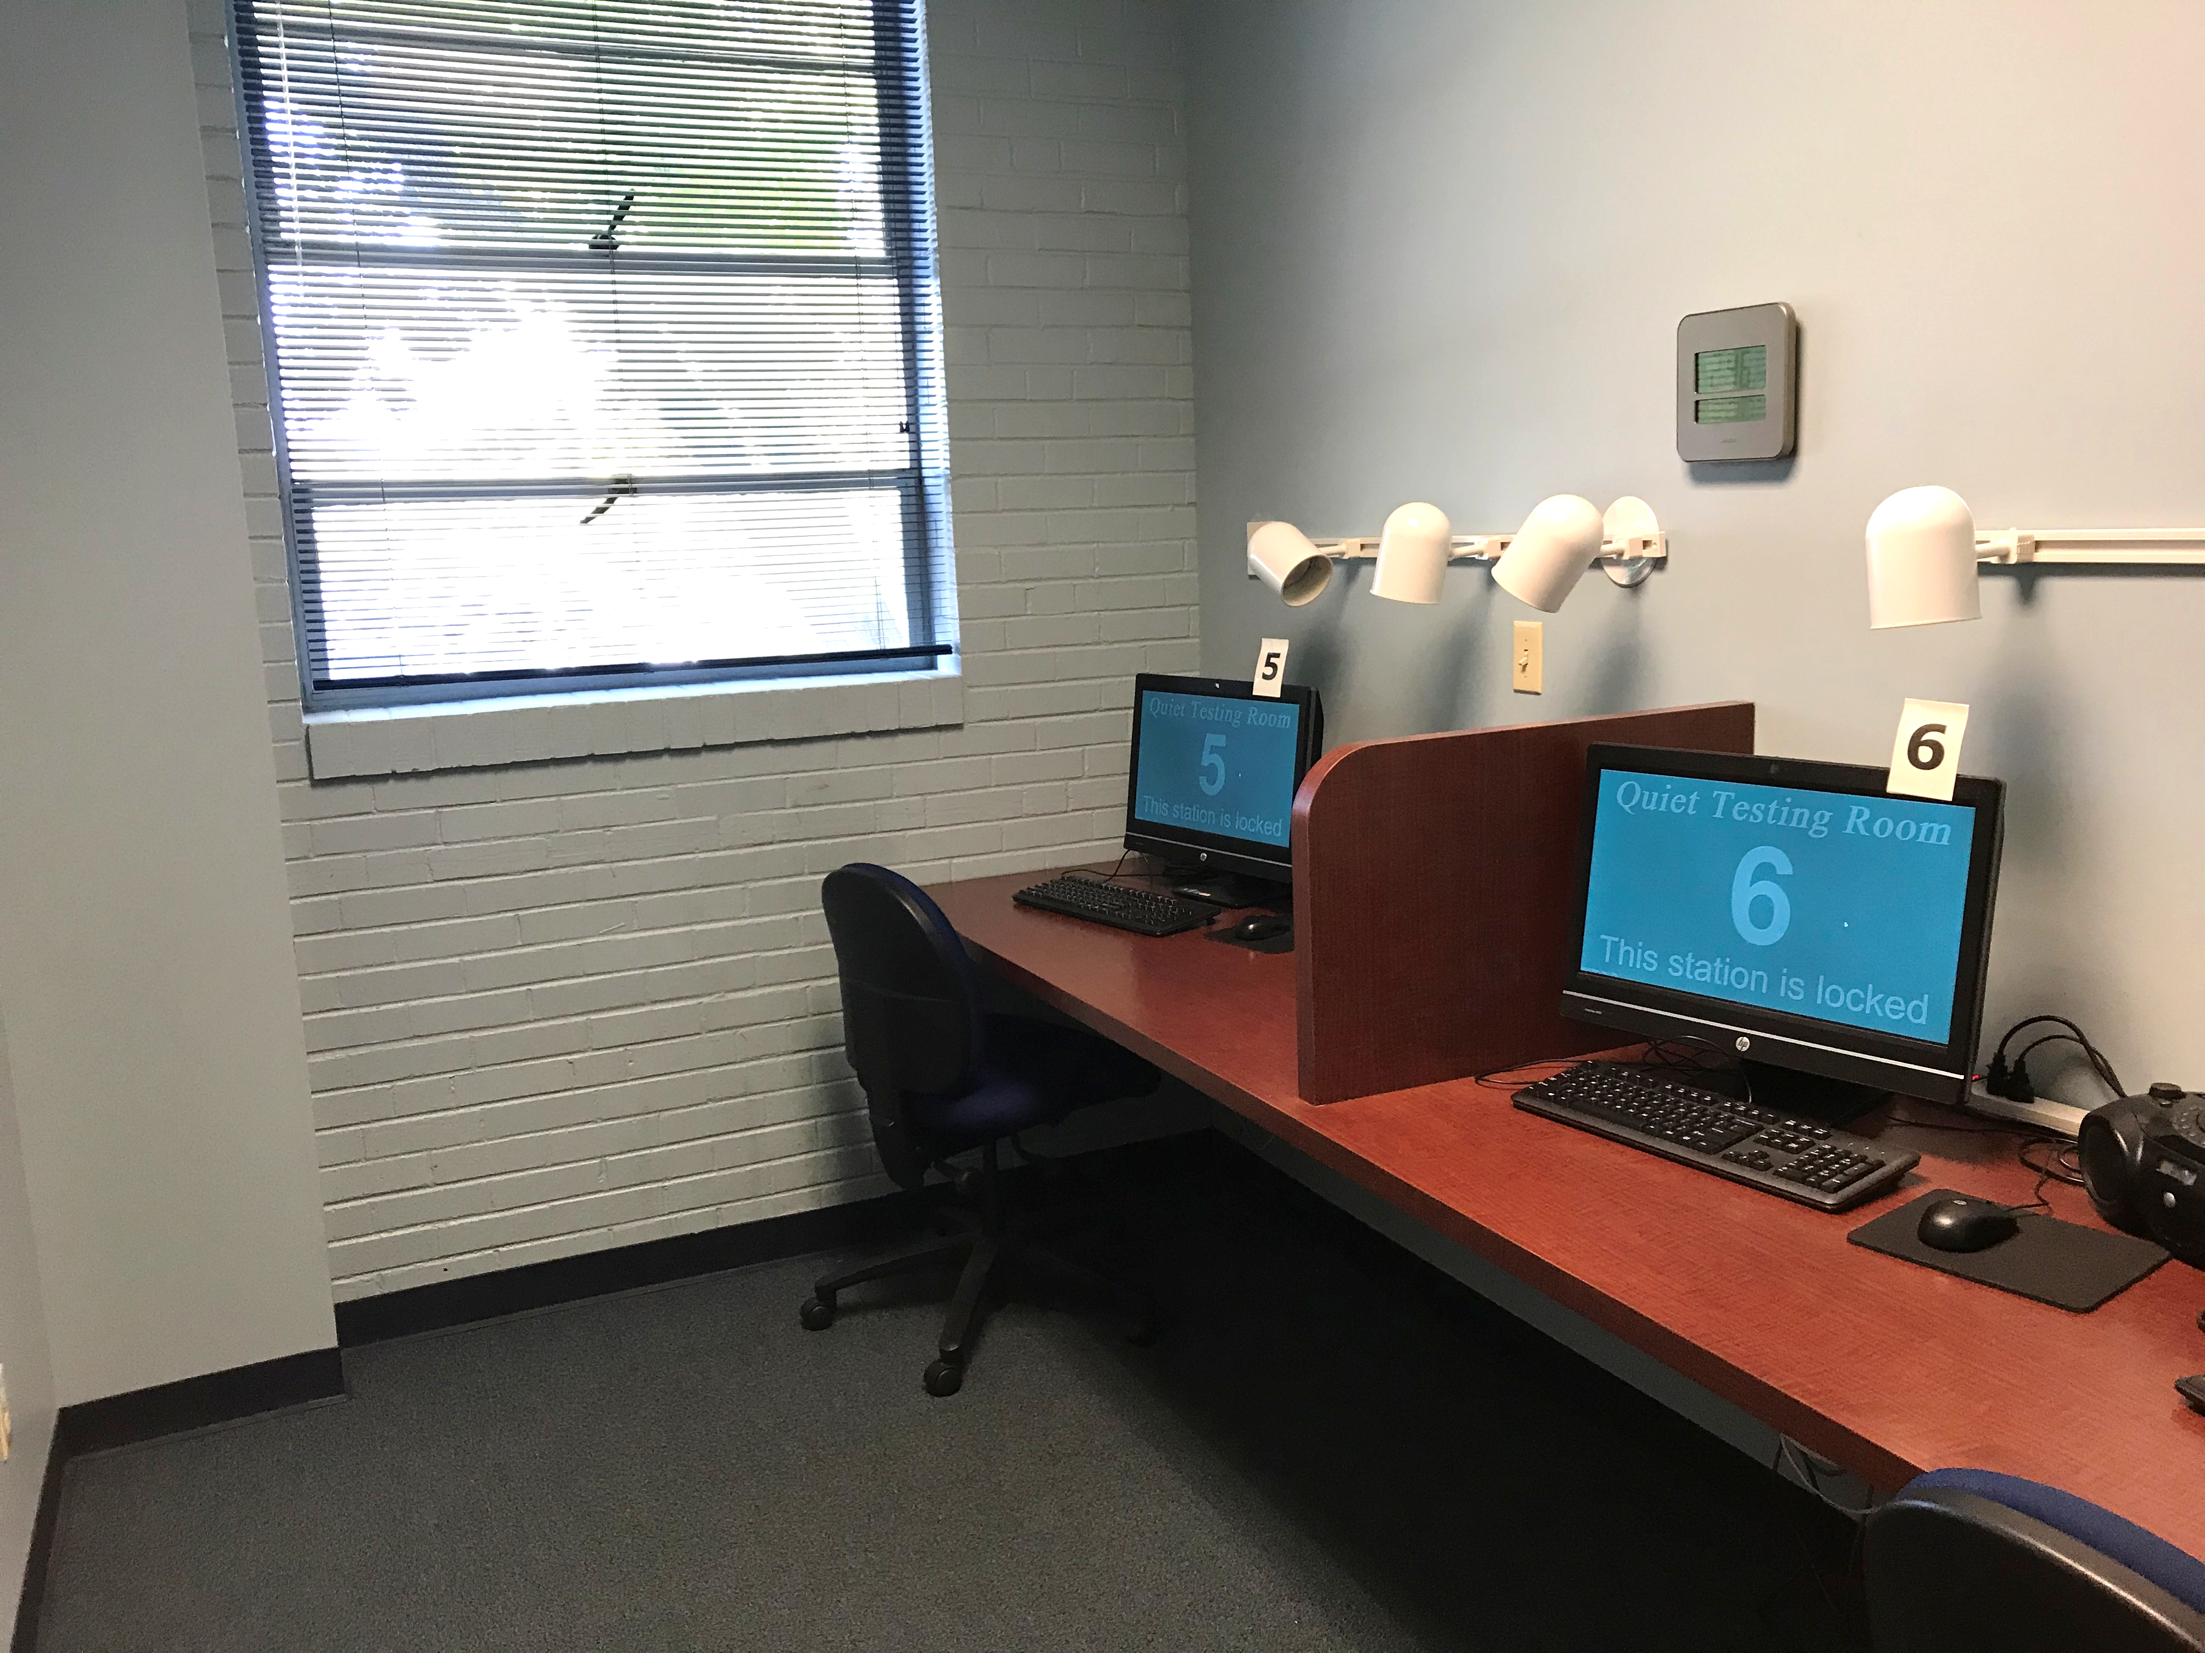
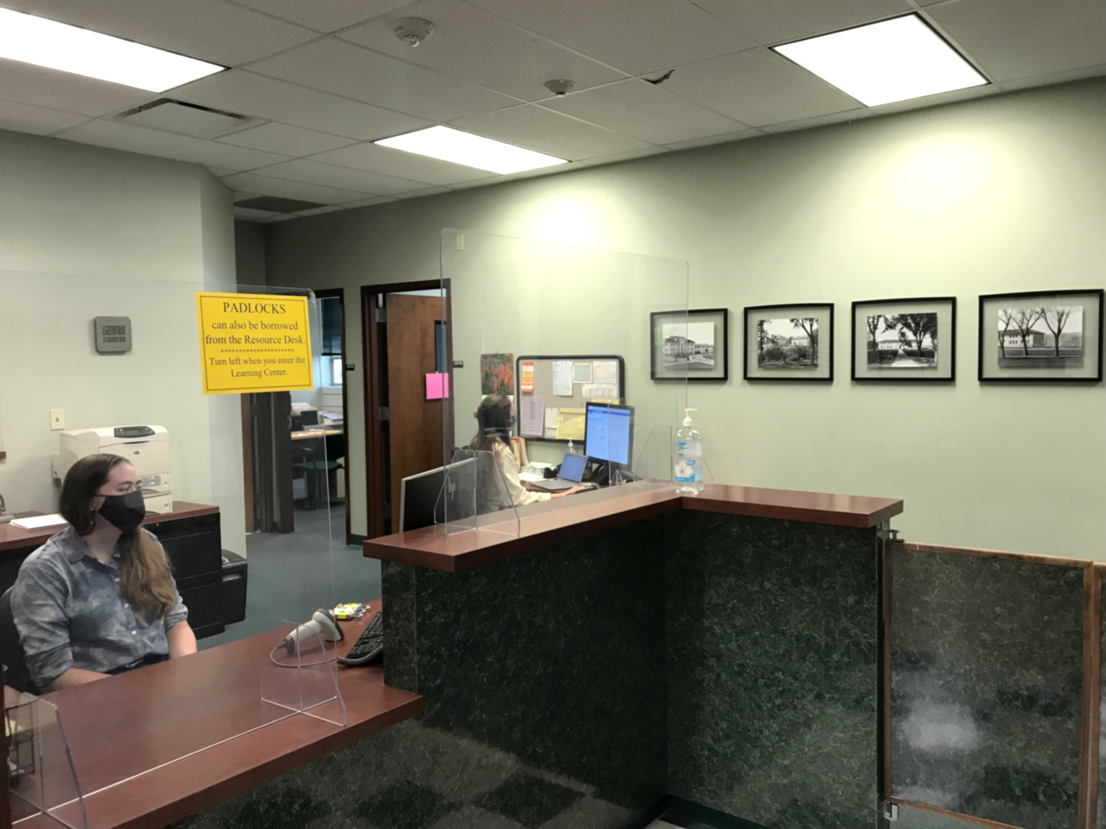
Tour: Office

Slide 38
Operations: Learning Center
No appointment needed, walk-in help with courses, Math Placement review
Extended/evening hours – open 45 hours per week
Course assistants circulate and help students with questions
Two small side rooms for students with common questions
Resource desk can lend:
Laptops or iPads (for use in the Center only)
TI-84 Calculators (for use in Center only)
Hardcopy textbooks (2-week loan)
Padlocks for lockers

Slide 39
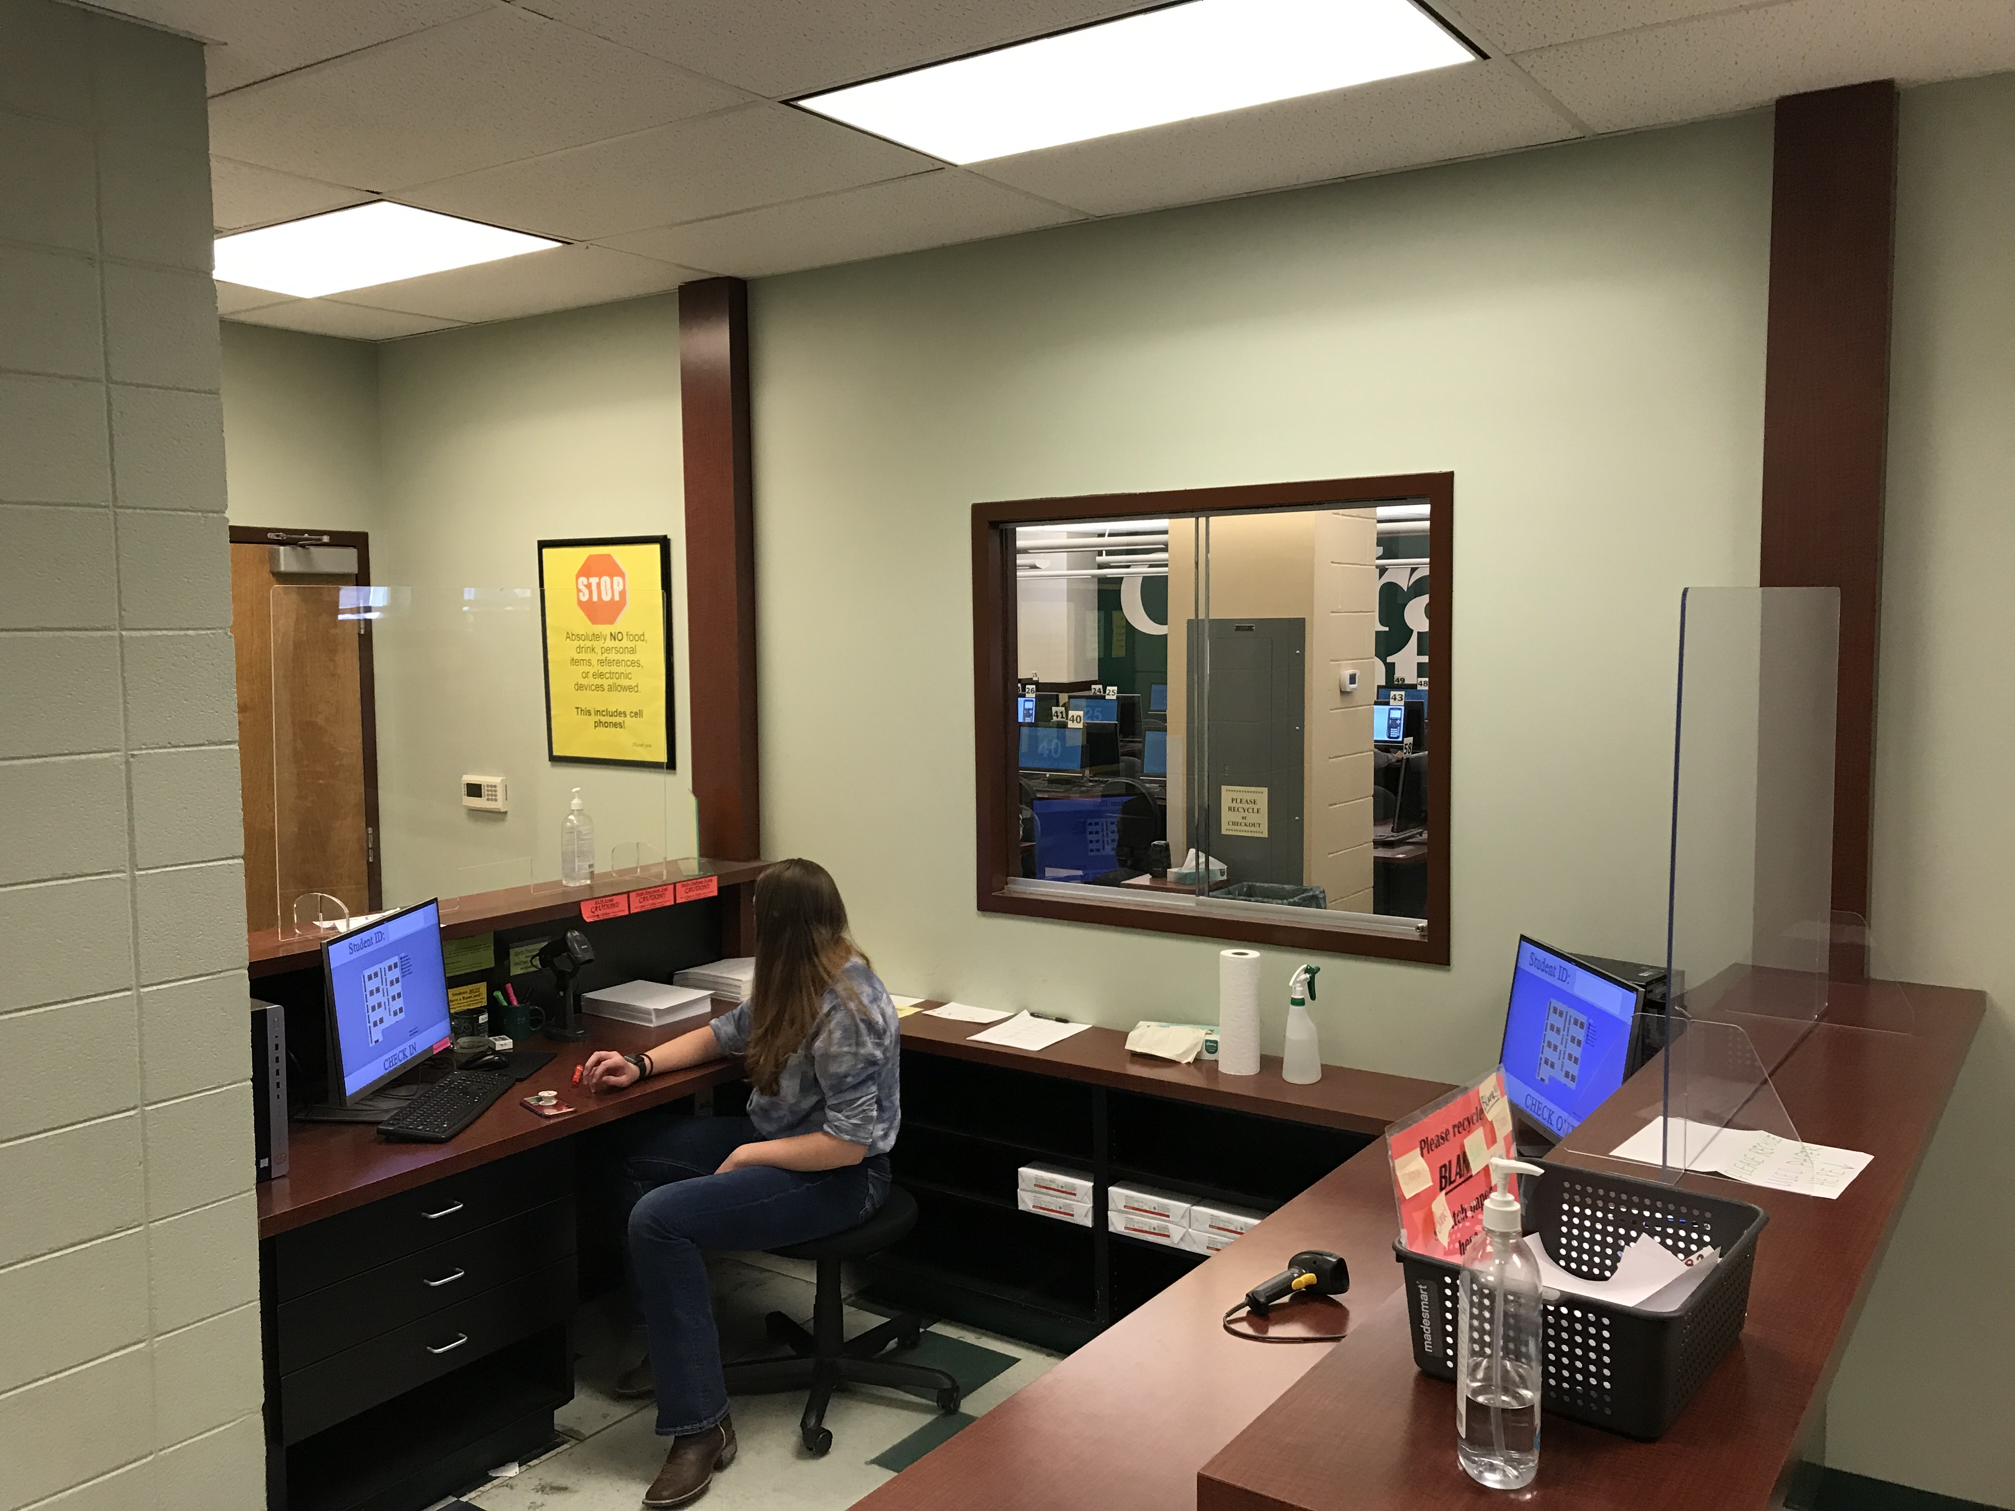
Operations: Testing
Proctored environment
Lockers to secure personal items – only ID card and pen/pencil in center.
96 testing stations on isolated network.
Custom built testing application.
On-screen TI-84CE calculator with “copy from calculator” button on numeric items.
Check-in station checks eligibility, assigns seat
Check-out station ensure exam submitted
Supports paper make-up exams for other departmental courses.

Slide 40
Operations: Office
Front desk to answer student questions, answer phones (undergrad)
Resource desk to lend and return resources (undergrad)
Quiet / special-needs testing area
Time-clock and bulletin board to request hour changes, etc.
Assistant director (GTA) or Director on duty during all open hours to handle situations
Requests for extensions
Accommodations
Cheating incidents
Conference room available for conversations with students in a less public setting.

Slide 41
Operations: Online
Automated jobs to update registrations, transfer credit, placement results, etc.
Automated reports of student progress to groups (athletics, engineering, etc.)
Tracking outstanding resource loans
Billing for placement, challenge exams, lost resource items
Batch to generate list of students for support emails based on status
Automated grade submission at end of term
Online proctoring system (built for COVID, but useful for special situations)

Slide 42
Outcomes

Slide 43
Drop/Withdraw/Fail Rates

Slide 44
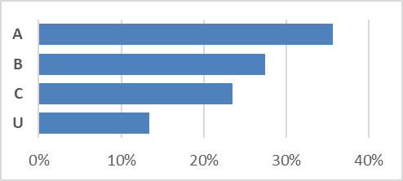
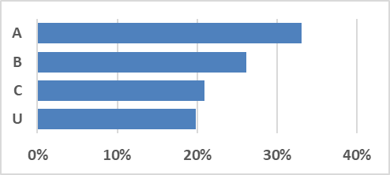
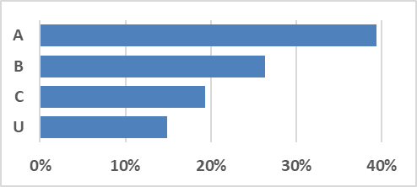
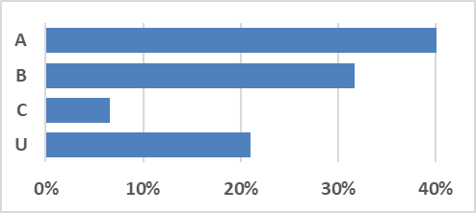
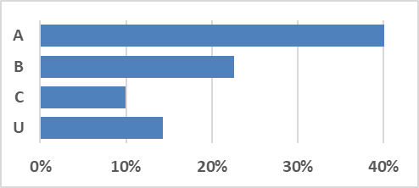
Grades in Completed Courses (Fall, 2019)
n = 1,141
n = 862
n = 1,414
n = 366
Typical on campus semester
n = 877

Slide 45
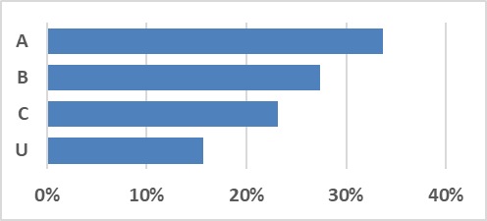
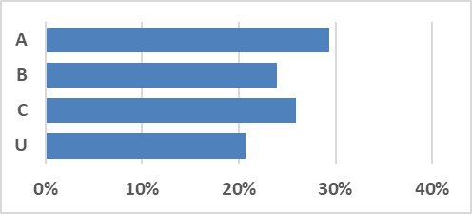
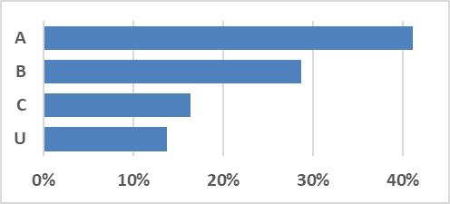
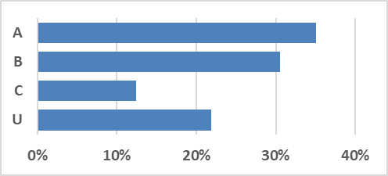
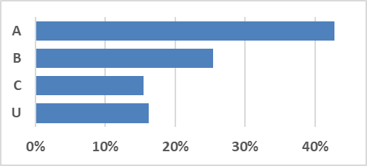
Grades in Completed Courses (Fall, 2020)
n = 987
n = 705
n = 1,231
n = 265
Remote semester due to COVID-19
n = 703

Slide 46
Future Plans

Slide 47
Improve the Curriculum
Build self-contained modules with instruction, assessments, activities.
Retool items to reduce “pattern-matching” behaviors
Reduce / eliminate calculator uses (to avoid students solving everything with graph/trace)
Remake video lessons, improve quality, clarity, consistency.
Create face-to-face component with inquiry-based activities.

Slide 48
Improve Teacher/Student Interactions
Students’ principal complaint about the program is that they don’t have an instructor.
Our plan:
Group students into cohorts of ~30 students
Assign each cohort to an instructor or a pair/trio of instructors
Each instructor has many cohorts, but students in each have same mix of courses
Instructors send support emails, handle student questions, are 1st line of communication
Instructors hold face-to-face sessions with IBL activities for core topic in each unit (4 sessions per semester per 1-credit course).
Students view their cohort as a small class – team activities are cohort-based.

Slide 49
Improve the Web Site
Create online help system where students who have missed a question more than twice get a “help me” button that connects to a (live) course assistant. The course assistant should be able to see what the student was working on when they clicked the button (with the course assistant’s view including hints like what technique the lesson is trying to teach)

