Slide 1

Models of cell dynamics and intercellular communication
Steve Benoit
Department of Mathematics
Colorado State University
This program is based upon collaborative work supported by a National Science Foundation Grant No. 0841259; Colorado State University, Thomas Chen, Principal Investigator, Michael A. de Miranda and Stuart Tobet Co-Principal Investigators. Any opinions, findings, conclusions or recommendations expressed in this material are those of the author(s) and do not necessarily reflect the views of the National Science Foundation.

Slide 2
Modeling Cell Dynamics & Communication
Outline:
Context – CSU research program
Observing cell motion – phenomenology & analysis
Modeling cell behavior – top-down vs. bottom-up
New approaches at mesoscopic scale
Results & discussion

Slide 3
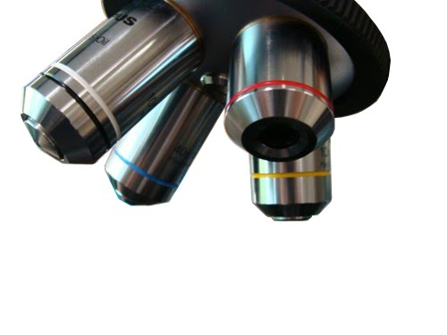
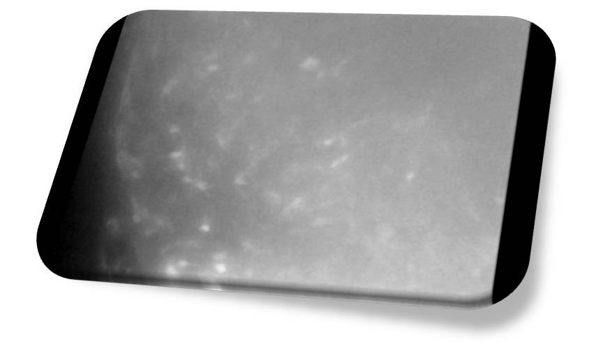
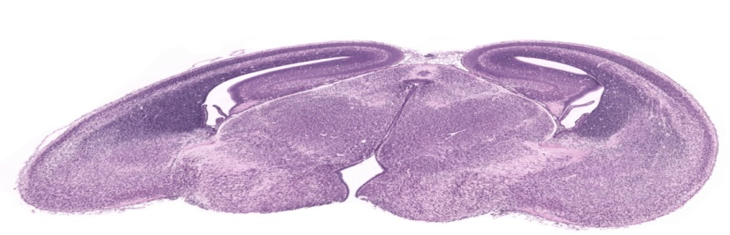
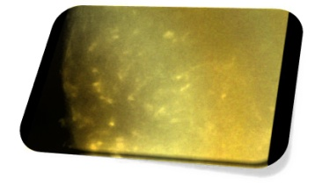
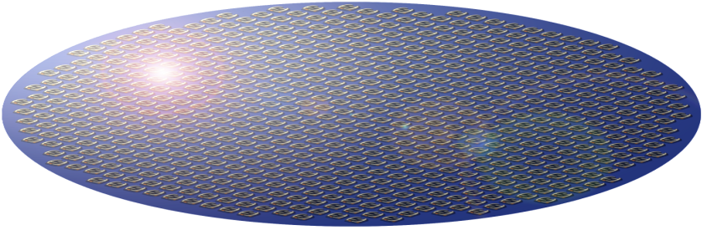
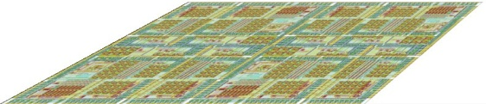

CSU Cell Communication Research
Fluorescence
Video Microscopy
Analysis
Optical Image
Tissue Slice Preparation
Tissue Sample
Data Acquisition & Processing
Electrochemical
Biosensor
Development
Biosensor Array
Composite Image
Microchip
Development
Analysis
Microchip
Chemical Image
Biomedical Sciences
Chemistry
Computer Science
Mathematics
Electrical & Computer Engineering

Slide 4
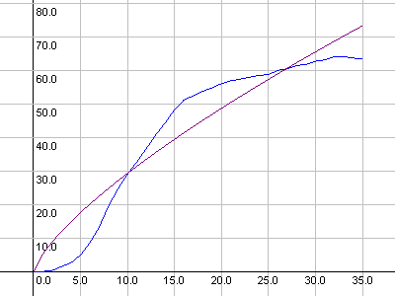


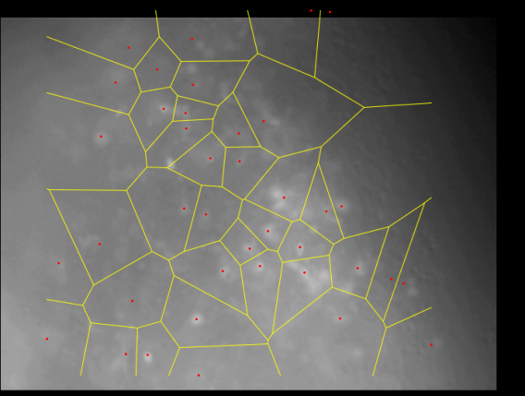
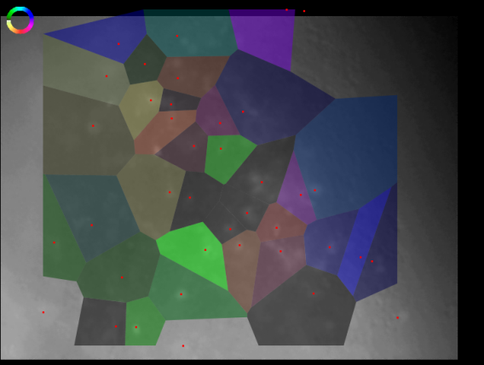
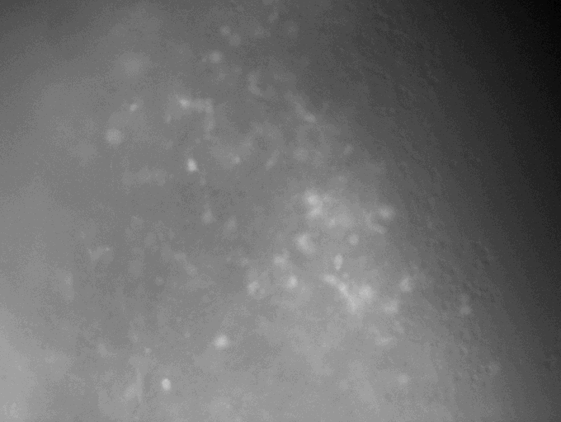
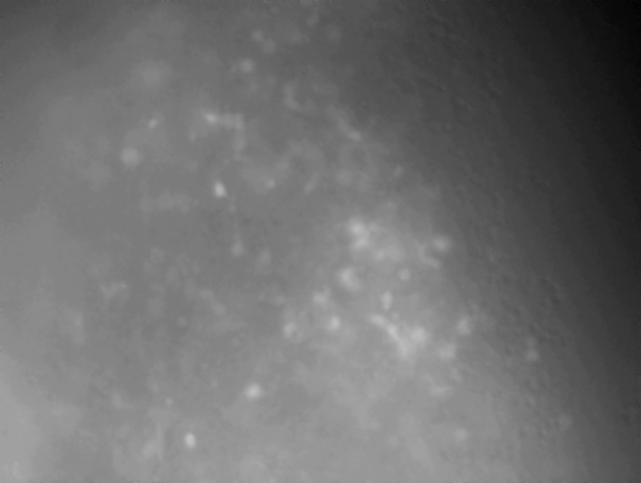
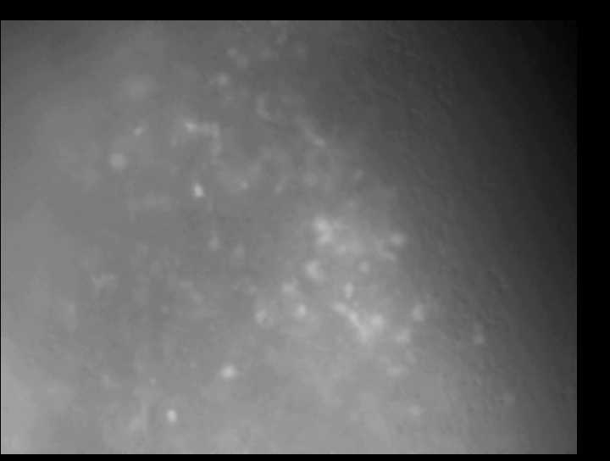
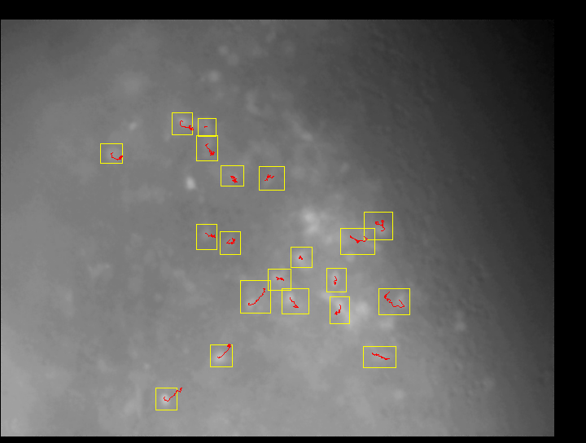
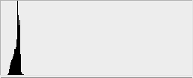
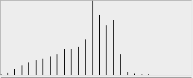
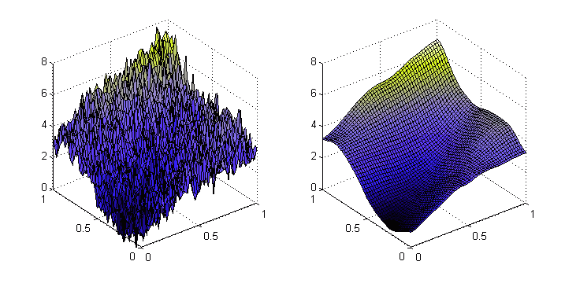
Cell Motion Analysis from Optical Images
Automated analysis tool:
Z-planes
}
}
}
}
Raw Image
Merged
Equalized
Smoothed
Stabilized
Trajectories
Analysis

Slide 5
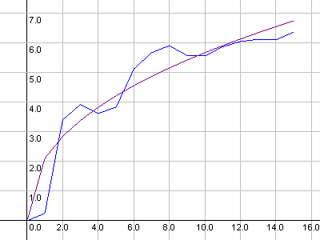
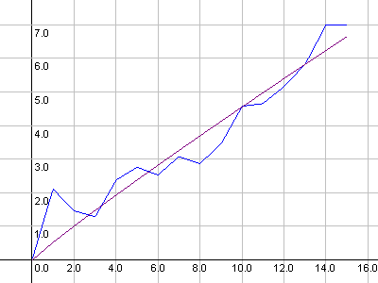
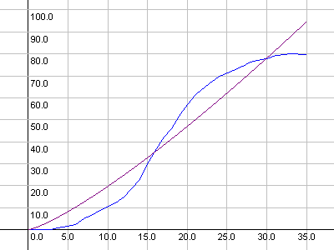
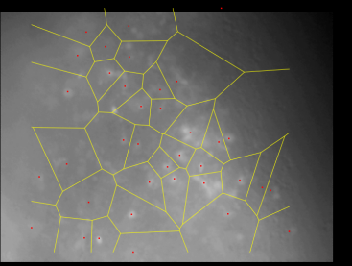
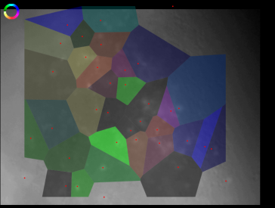
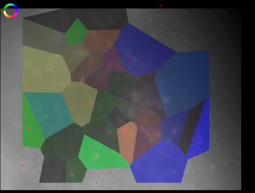
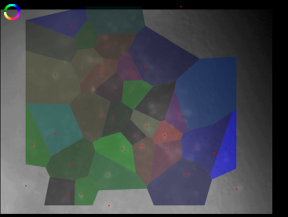
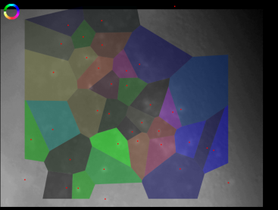
Cell Motion Analysis from Optical Images
Automated analysis tool:
Best-fit curves for model:
α ≈ 1: diffusive behavior
α < 1: subdiffusive behavior
α > 1: superdiffusive behavior
α=.42
α=.93
α=1.25
Voronoi diagram and visualizations:
Voronoi
α
K
Speed
Distance

Slide 6
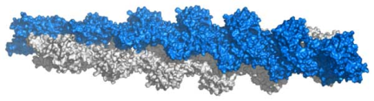
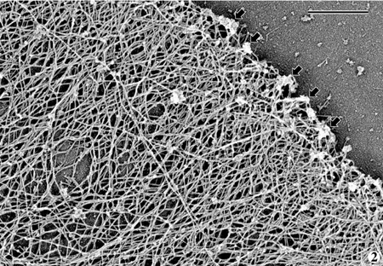
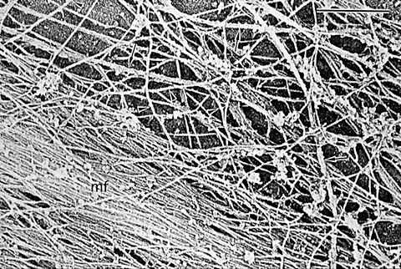
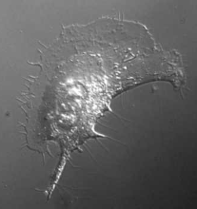
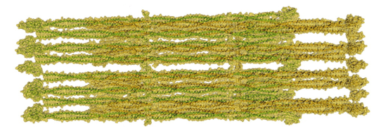
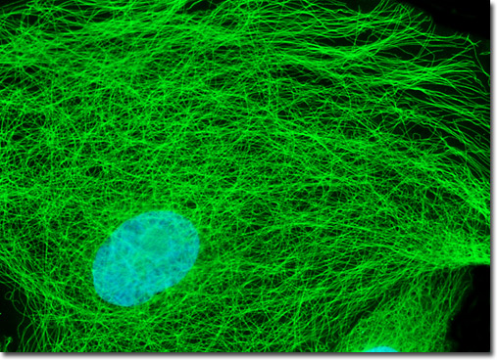
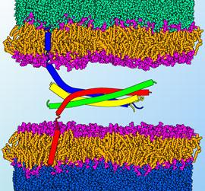
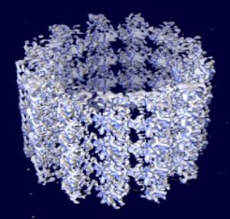
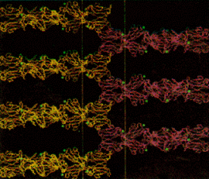
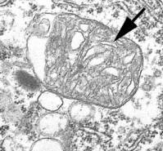
Challenges of modeling cell behavior
Cell mechanics:
Actin Microfilaments
Intermediate Filaments
Membrane & Adhesion
Organelles
Microtubules

Slide 7
Challenges of modeling cell behavior
Examples of cell motion & signaling:
Neutrophil
Macrophage
Neuron
T Cells
Examples of cell mechanics:
Actin motility
Actin-Induced
Movement
Microtubule
Dynamics
Adhesion

Slide 8

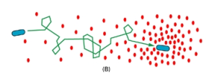
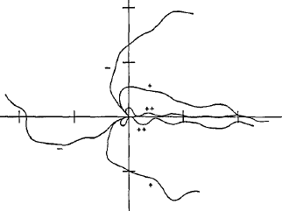
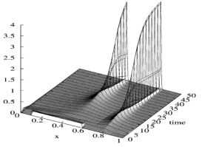
History: “Top-Down” Models
Continuum model of cell concentration
(e.g. Keller & Segel -1971)
Random walk with bias
(e.g. Alt – 1980)
Stochastic model
(e.g. Tranquillo – 1988)
Hyperbolic continuum model
(e.g. Hillen & Stevens - 2000)

Slide 9
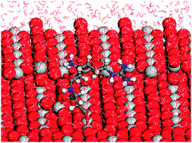
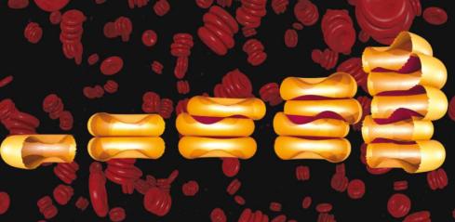
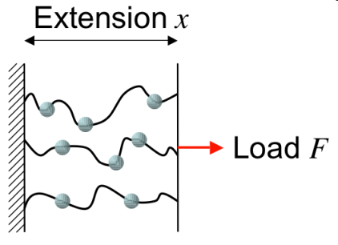
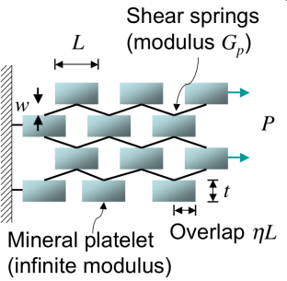
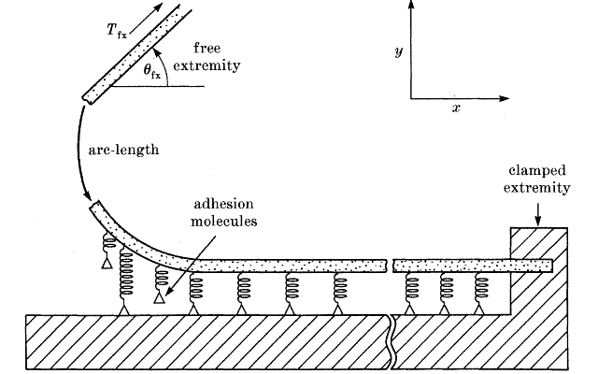
History: “Bottom-Up” Models
Molecular dynamics models
(~ 7x10¹⁵ atoms per cell)
Membrane models
Cytoskeleton models
Adhesion modulation models

Slide 10
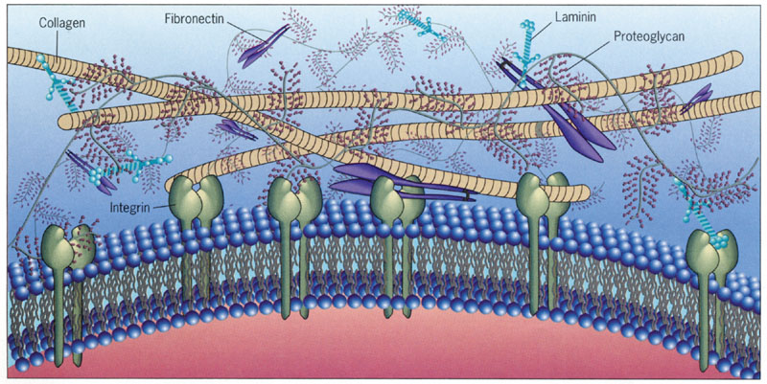
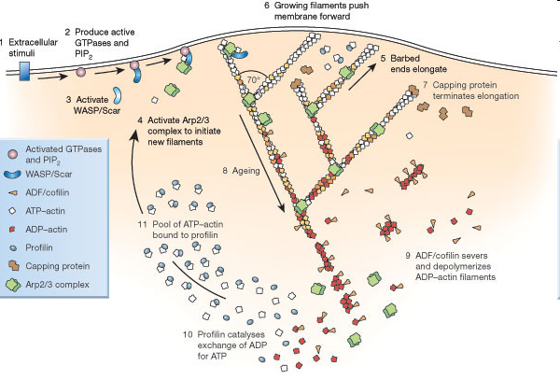
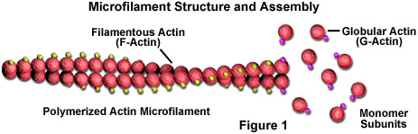
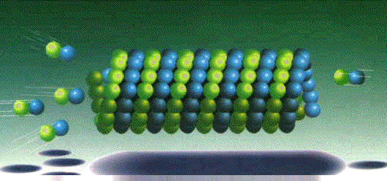
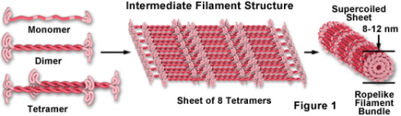
Mechanical Components

Slide 11
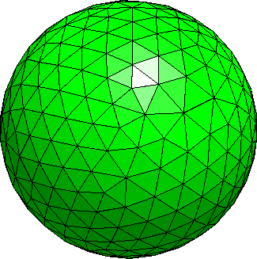
Models for Mesoscopic Simulation
Plasma Membrane
Energy Functional Terms:
Axial displacement
Normal averaging
Radial Lennard-Jones
Each disc acts as sensor
~500-1000 discs per cell
Disc Model
Triangulation
Simulation

Slide 12
Models for Mesoscopic Simulation
Organelles
Organelles are treated just as membranes
Different energy parameters
Interaction Terms:
Simple Lennard-Jones
Simulation

Slide 13
Models for Mesoscopic Simulation
Cytoskeleton
Collection of Lennard-Jones spheres
Interacts with other actin spheres and membrane discs
Interaction Terms:
Simple Lennard-Jones

Slide 14
Models for Mesoscopic Simulation
Cytoskeleton Dynamics & Signaling
Membrane discs are activated by signals
Actin spheres close to activated discs are activated / created
Activated spheres grow (polymerize) then divide
Global rate of sphere shrinkage (depolymerization) to restore monomer pool
Signals (Diffusive)
Simulation

Slide 15
Directions for Future Work
Parallelization and optimization
Simulations with 1000-5000 cells
Mitosos and apoptosis
Boundary/interior conditions (ventricle, radial glia)

Slide 16
Acknowledgements
Colorado State University
Tom Chen, Michael de Miranda
CSU Biomedical Sciences Department and the Tobet Lab
Stuart Tobet, Matt Stratton, Krystle Frahm, Brian Searcy
CSU Department of Mathematics
Vakhtang Putkaradze
University of Ljubljana & Jožef Stefan Institute
Primož Ziherl
The author would like to thank the National Science Foundation for support under Grant No. 0841259.

