Slide 1

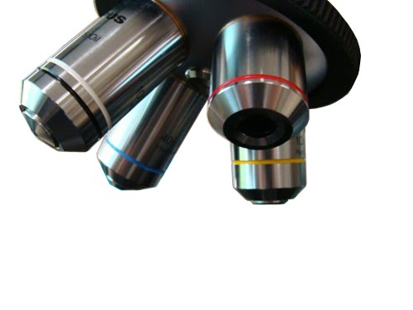
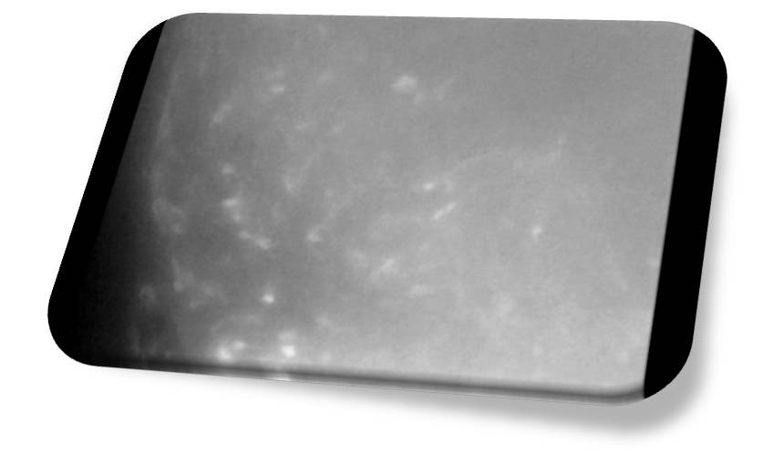
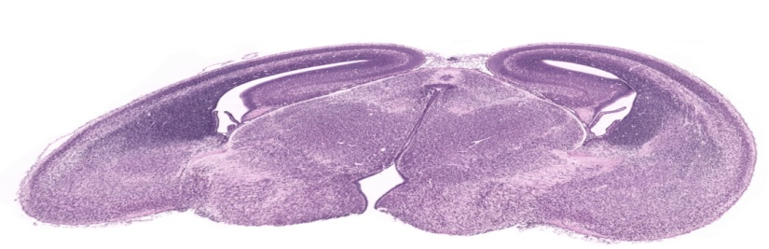
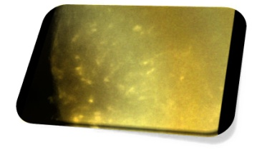
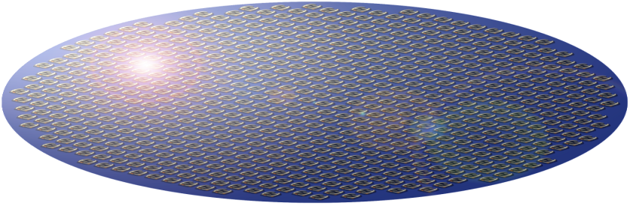

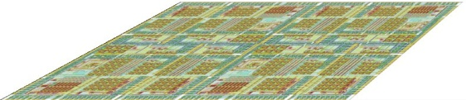
Biomedical Sciences
This program is based upon collaborative work supported by a National Science Foundation Grant No. 0841259;
Colorado State University, Thomas Chen, Principal Investigator, Michael A. de Miranda and Stuart Tobet Co-Principal Investigators.
Any opinions, findings, conclusions or recommenda-tions expressed in this material are those of the author(s) and do not necessarily reflect the views of the National Science Foundation.
Chemistry
Electrical & Computer Engineering
Computer Science
Mathematics
Colorado High-school Interdisciplinary Project
Fluorescence
Video Microscopy
Analysis
Optical Image
Tissue Slice Preparation
Tissue Sample
Data Acquisition & Processing
Electrochemical
Biosensor
Development
Biosensor Array
Composite Image
Microchip
Development
Analysis
Microchip
Chemical Image
Dec. 7, 2010
Notes:
This slide shows the overall interdisciplinary project structure and how each department contributes to the project.
Our goal is to understand how chemical signals influence the motion of cells during embryonic brain development. To do this, we are developing a hybrid visual/chemical imaging system in which live tissue can be imaged from above using fluorescence video microscopy and from below using a high-density array of biosensors (chemical electrodes that can detect specific biologically active chemicals). The sensor array will be integrated with a microchip that will gather data, amplify and convert into digital format, and store for later retrieval. The result will be an optical image (from above), a chemical image (from below), and a resulting combined image.
The Biomedical Sciences department handles the live tissue slice preparation and handling, and performs video microscopy.
The Chemistry depart is developing and testing integrated circuit biosensors for the signaling compounds of interest (NO, GABA). The Electrical & Computer Engineering department is developing the microchip that will interface with the biosensor array.
The Computer Science department is developing data acquisition software to offload the chemical image data from the chip.
The Mathematics department is providing analysis of the resulting images as well as modeling of the cellular system under study.
This presentation covers the area circled in red – analysis of the optical images/movies gathered from the fluorescence microscope.

Slide 2


Automated Analysis of Image Sets
Metamorph
(Commercial software)
ANALYSES:
Frame extraction
Brightness/contrast
Noise filtering
Motion compensation
Cell identification
Trajectory extraction
Trajectory analysis
Analysis Tool
(CSU Software)
Raw TIF Image Files
An array of analyzed images, spreadsheets, and data files…
Notes:
This presentation describes an automated analysis tool that takes data generated by the microscope and builds up an analysis of cell movements.
The Metamorph software interfaces with the microscope and controls its camera to generate images on a timed schedule. With each image, the sample is illuminated by a bright flash at a particular wavelength, after which certain proteins in the cells fluoresce, giving an image where light colored objects are cells.
The software generates a series of TIF image files, each representing a single point in time, and each containing some number of “z-planes”, or images with the focal plane shifted a few microns from each other. The reason for doing this is to increase the ability to distinguish individual cells by sweeping the focal plane through roughly one cell body size.
The list on the right shows the steps the analysis tool will go through to perform its analysis of a series of these multi-plane images.

Slide 3
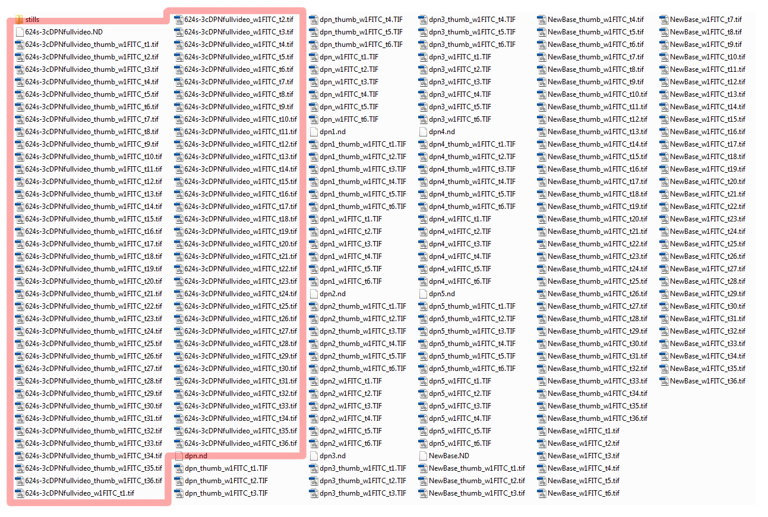
Automated Analysis of Image Sets
Metamorph
Raw TIF Image Files
Notes:
The Metamorph software generates a series of TIF image files, each representing a single point in time, and each containing some number of “z-planes”, or images with the focal plane shifted a few microns from each other. The reason for doing this is to increase the ability to distinguish individual cells by sweeping the focal plane through roughly one cell body size.
This slide shows a screenshot of a typical directory containing a number of Metamorph sequences. The area outlined in red indicates a combined sequence with 36 time points.
This is the starting point for the automated analysis tool.

Slide 4

Automated Analysis of Image Sets
Analysis Tool
(CSU Software)
ANALYSES:
Frame extraction
Brightness/contrast
Noise filtering
Motion compensation
Cell identification
Trajectory extraction
Trajectory analysis
Raw Frame
(Time = t, z = 0)
Raw Frame
(Time = t, z = 1)
Raw TIF Image File
(Time = t)
Raw Frame
(Time = t, z = 2)
}
MERGE
Raw Frame (TIF)
(Time = t)
Notes:
The first step in the process is to take each raw TIF file, which contains several Z planes, and extract the individual Z planes as distinct image files.
Then, these image files are combined in such a way that a cell that was in focus in ANY of the Z planes will be included in the composite image. This is done by sampling all Z plane images and keeping the pixel value with the brightest intensity. This assumes that in-focus cells will be small and bright, while out-of-focus cells will be smeared out and dim.

Slide 5

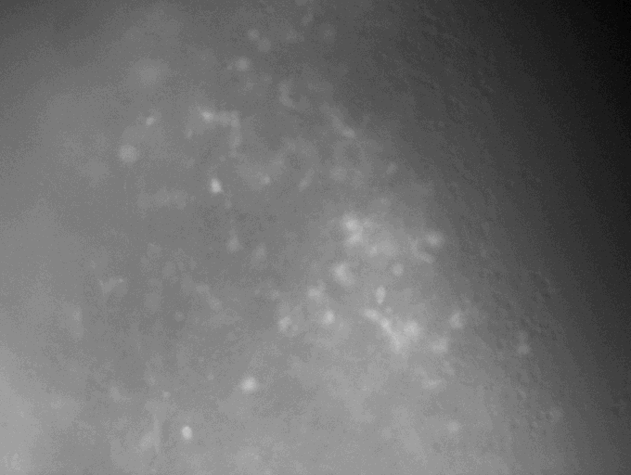
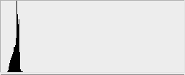
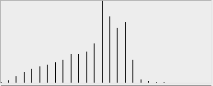
Automated Analysis of Image Sets
Analysis Tool
(CSU Software)
ANALYSES:
Frame extraction
Brightness/contrast
Noise filtering
Motion compensation
Cell identification
Trajectory extraction
Trajectory analysis
Raw Frame (TIF)
(Time = t)
Equalized (PNG)
(Time = t)
}
Movie (MOV)
Original brightness
Adjusted brightness
Notes:
Next, we re-scale the brigtness in the raw TIF images to include the whole range from black to white (as the images come from the microscope, they appear to be all black, since the 16-bit brightness values are all concentrated at the bottom end of the scale).
This is a little more complex than simply scaling the values so the brightest pixel maps to white, which would result in a single very bright pixel washing out the rest of the image. Rather, after we map all images using a simple linear scale from black to white, we compute the average intensity of each image and compare to the average intensity of the entire series, then adjust each image to make its average nearly equal to the overall average. This prevents “flashes” that occur when scaling using the naive approach of a linear black to white scaling.
At this stage, the tool also generates a QuickTime movie using the brightness-adjusted images.

Slide 6
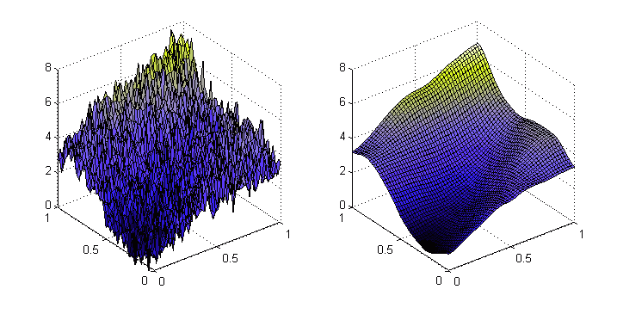
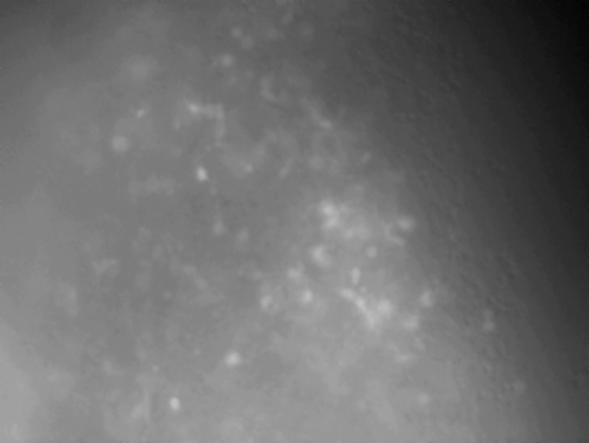
Automated Analysis of Image Sets
Analysis Tool
(CSU Software)
ANALYSES:
Frame extraction
Brightness/contrast
Noise filtering
Motion compensation
Cell identification
Trajectory extraction
Trajectory analysis
Equalized (PNG)
(Time = t)
Smoothed (PNG)
(Time = t)
}
Movie (MOV)
Notes:
Before cell positions can be found, we smooth the raw images using a Gaussian kernel (a basic filter in which the new value of a pixel is based on its old value plus some contribution from its neighbors). This has the effect of smoothing out noise without substantially changing actual values. The two graphs in the lower left illustrate the concept.
Again, a movie is made at this step.

Slide 7
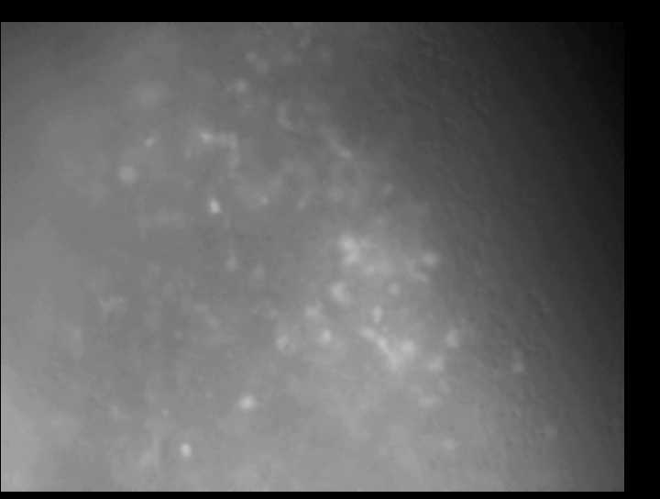
Automated Analysis of Image Sets
Analysis Tool
(CSU Software)
ANALYSES:
Frame extraction
Brightness/contrast
Noise filtering
Motion compensation
Cell identification
Trajectory extraction
Trajectory analysis
Smoothed (PNG)
(Time = t)
Stabilized (PNG)
(Time = t)
}
Movie (MOV)
GOAL:
Stabilize the center of the frame…
Notes:
During the collection of the microscopy images, the sample may move beneath the microscope objective, resulting in global tissue movements in the images over time. We don’t want these movements to be interpreted as a component of cell motions, so we stabilize the frames before extracting cell positions.
This is done by taking each pair of frames and finding the X and Y offsets for which the center third of the frame correlates best between frames. We use the center third since motions toward the boundaries of the sample could be due to tissue shrinkage, and at this stage we’re concerned with compensating for global motion. This also makes the center of the visible sample a reference point against which tissue shrinkage can be measured later.
As before, the tool generates a movie of the motion-compensated frames. You can see how a black border has been added around the frame (and each frame is a little larger to accommodate this). This allows the original frames to “crawl” through the new larger frame as the sample moved during filming, leaving the tissue stationary near the center of the frame.

Slide 8
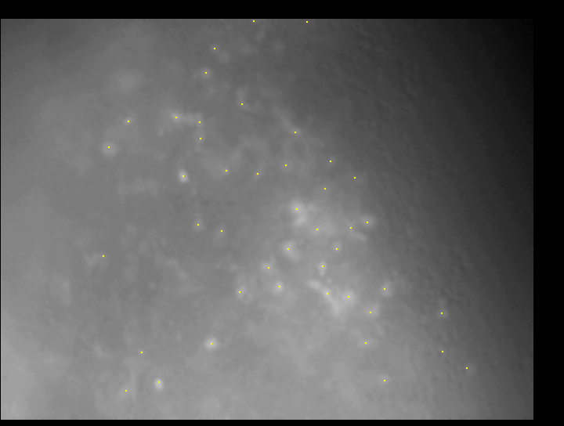
Automated Analysis of Image Sets
Analysis Tool
(CSU Software)
ANALYSES:
Frame extraction
Brightness/contrast
Noise filtering
Motion compensation
Cell identification
Trajectory extraction
Trajectory analysis
Stabilized (PNG)
(Time = t)
Cells (PNG)
(Time = t)
}
Movie (MOV)
Cell Positions
Cell Vectors
Tissue Vectors
(CSV - Excel)
Notes:
We can now extract cell positions. We detect maxima in intensity as cells, subject to several constraints:
- maxima that fall below some intensity threshold are ignored
- maxima must be surrounded by a darker region to be considered as cells
- multiple maxima that are a few pixels apart are merged and considered as a single cell
The output of this step is a set of image files with maxima marked with yellow dots, a movie (that includes the yellow dots), and a set of CSV files (readable by Excel) that give the raw X and Y coordinates of the cells for each frame.

Slide 9
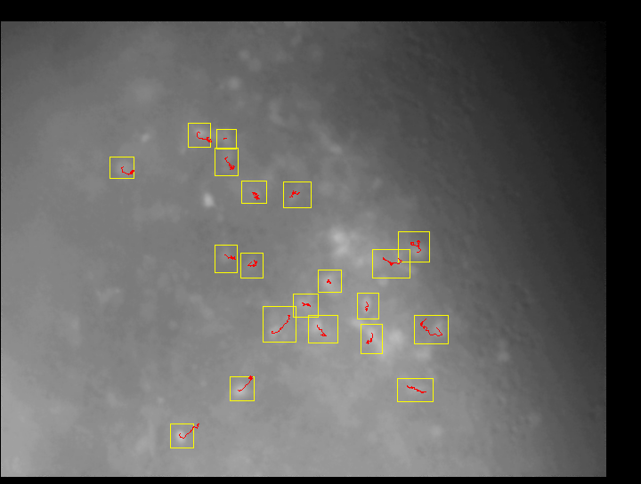
Automated Analysis of Image Sets
Analysis Tool
(CSU Software)
ANALYSES:
Frame extraction
Brightness/contrast
Noise filtering
Motion compensation
Cell identification
Trajectory extraction
Trajectory analysis
Cells (PNG)
(Time = t)
Trajectories (PNG)
(Time = t)
}
Movie (MOV)
Trajectory Data
(CSV - Excel)
Raw Data
(DAT files)
Notes:
The next phase correlates cell position between frames, building up trajectories of cells. Cells are considered part of a trajectory if their position does not change more than some threshold amount between frames.
Some trajectories stop partway through the video (the cell moved out of the Z planes we are visualizing), and some new trajectories start during the movie (as cells move into the focal plane). Each trajectory is characterized by a sequence of (x, y) coordinate positions and a start and end frame number.
At this stage, we also compensate for tissue shrinkage by analyzing the local region around each trajectory for bulk drift (to do this, we define a small box around the cell (the yellow boxes in the image in the lower right), and correlate the contents of this box (ignoring the cell itself) between frames. In this way, the box moves “with the tissue”, and we can measure the position of the cell relative to the box to get a cell’s trajectory relative to its surrounding tissue.
The output of this step is a set of images with the trajectories and box regions included, a movie that includes the trajectories and boxes, a CSV file with the trajectory data (x and y coordinates as well as box offsets for every frame), and a set of ‘.dat” files with trajectory data in a format that the analysis step uses.

Slide 10
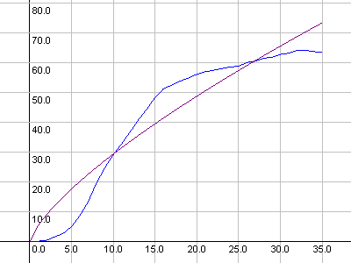
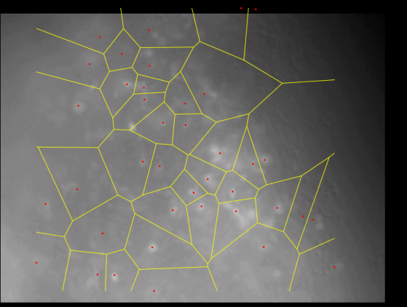
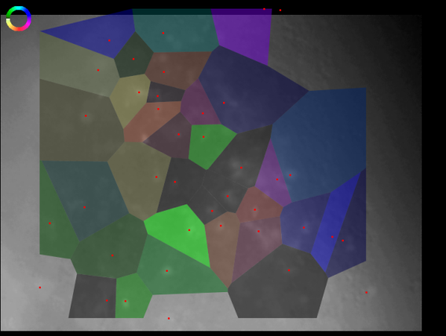
Automated Analysis of Image Sets
Analysis Tool
(CSU Software)
ANALYSES:
Frame extraction
Brightness/contrast
Noise filtering
Motion compensation
Cell identification
Trajectory extraction
Trajectory analysis
Raw Data
(DAT files)
Report & Summary
(CSV - Excel)
Diffusion Curve Fits
Region detection
Visual Analyses
Notes:
Finally the tool performs an analysis of the cell motion from the trajectory files generated in the last step.
For every trajectory, we fit an exponential curve of the form <(r-<r>)²> = 4Ktª, where K is the diffusion constant and a is a diffusion exponent (where a<1 means subdiffusive behavior, a=1 means diffusive behavior, and a>1 means superdiffusive behavior). We also compute the angle of cell motion, average cell speed, and distance traveled.
Then we build a Voronoi diagram around each cell position, in which each region contains one cell and represents the set of points for which that cell is the nearest cell detected. We use this diagram to visualize the results in a series of diagrams, in which color represents cell direction (the color wheel is visible in the upper-left corner of the drawing in the lower right of the slide), and brightness represents some characteristic (K, a, distance, or speed). This allows us to quickly pick out regions in the tissue where behaviors are similar. Our hope is that this will correlate will with distributions of chemical signaling agents once the chemical imaging system is finished.

Slide 11
Automated Analysis of Image Sets
Acknowledgements:
CSU Biomedical Sciences Dept and the Tobet Lab:
S. Tobet, M. Stratton, K. Frahm and B. Searcy
CSU Department of Mathematics V. Putkaradze
University of Ljubljana & Jožef Stefan Institute P. Ziherl
The author would like to thank the National Science Foundation for support under Grant No. 0841259.

